Slide 1
Presentation slide based on "Slagter - Drawing Fetal circulation - no labels" by Ron Slagter and O. Paul Gobée, LUMC, license: CC BY-NC-SA

Slide 2
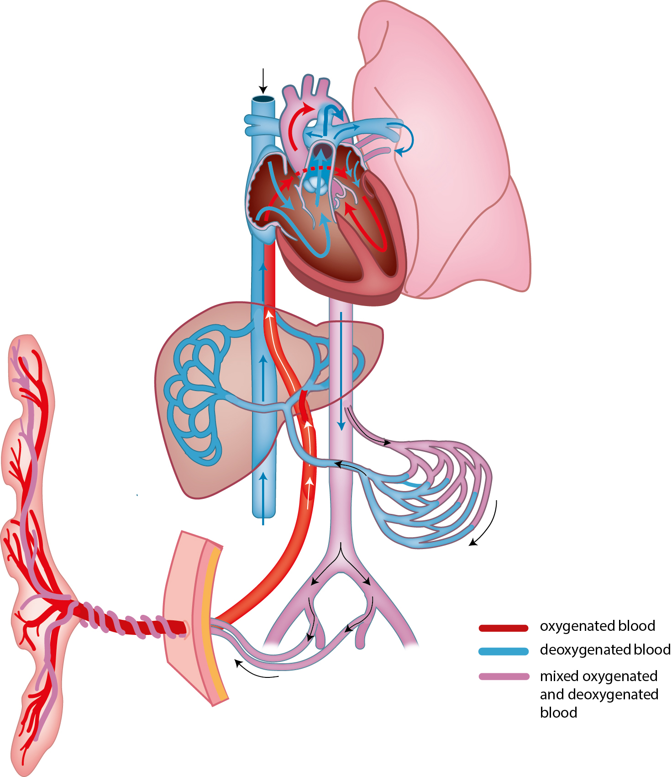
ductus arteriosus
(Botalli)
foramen ovale
v. umbilicalis/
umbilical vein
ductus venosus/
venous duct
umbilical cord
a. umbilicalis/
umbilical artery

