Slide 1
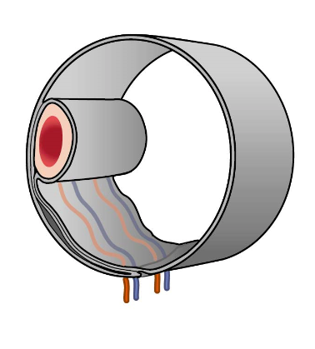
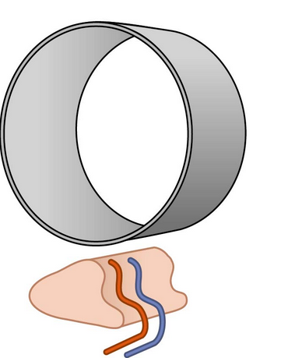
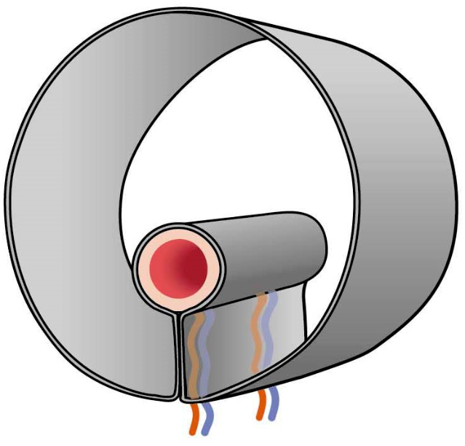
intraperitoneal
secondary
retroperitoneal
(primary)
retroperitoneal/
extraperitoneal

Slide 2
intraperitoneaal
secundair
retroperitoneaal
(primair)
retroperitoneal/
extraperitoneal

