Slide 1
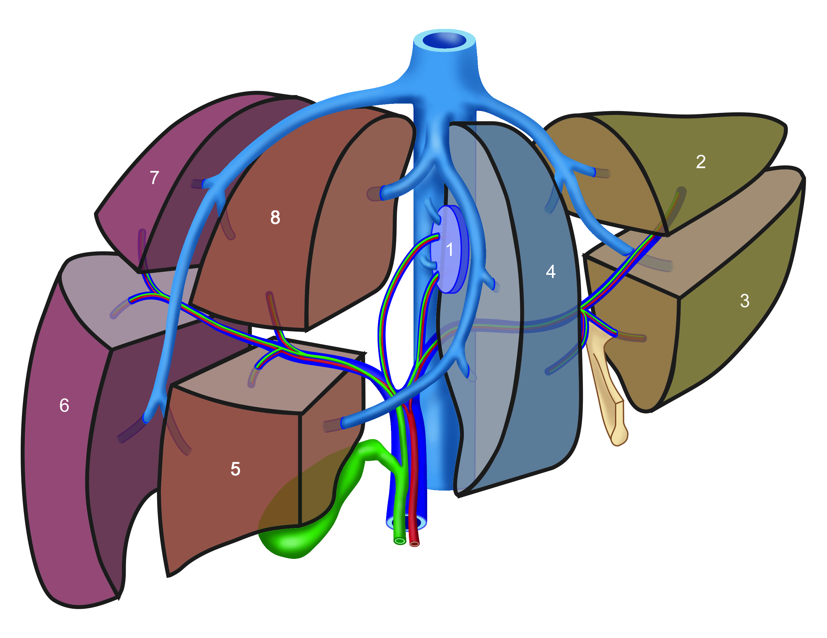
right, intermediate, left hepatic vein
inferior vena cava
Liver segment 1: caudate lobe
Liver segment 4: quadrate lobe
falciform ligament
portal vein of liver
bile duct
proper hepatic artery
Division liver in L/R:
physiological
R
L
visually (anatomical)
R
L

Slide 2
vena hepatica dextra, intermedia, sinistra
vena cava inferior
Lever segment 1: lobus caudatus
Lever segment 4: lobus quadratus
ligamentum falciforme
vena portae hepatis
ductus choledochus
arteria hepatica propria
Verdeling lever in L/R:
fysiologisch
R
L
uitwendig/visueel
(anatomisch)
R
L

