Slide 1


Presentation slide
Visible Human - Photo Renal Fascia -Presentation slide
photo: Visiible Human, female, National Library of Medicine, USA
labels: O. Paul Gobée, MD, dept. Anatomy& Embryology, LUMC
license: Creative Commons Attribution NonCommercial ShareAlike

Slide 2
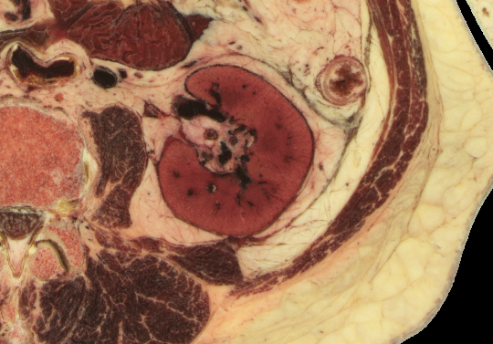
Renal fascia (Gerota’s fascia)

