Slide 1
Umbilical folds and ligaments labeled
Based on "The umbilical folds, no labels" at AnatomyTOOL.org by S. Bas Blankevoort, LUMC and O. Paul Gobée, LUMC, license: CC BY-NC-SA

Slide 2
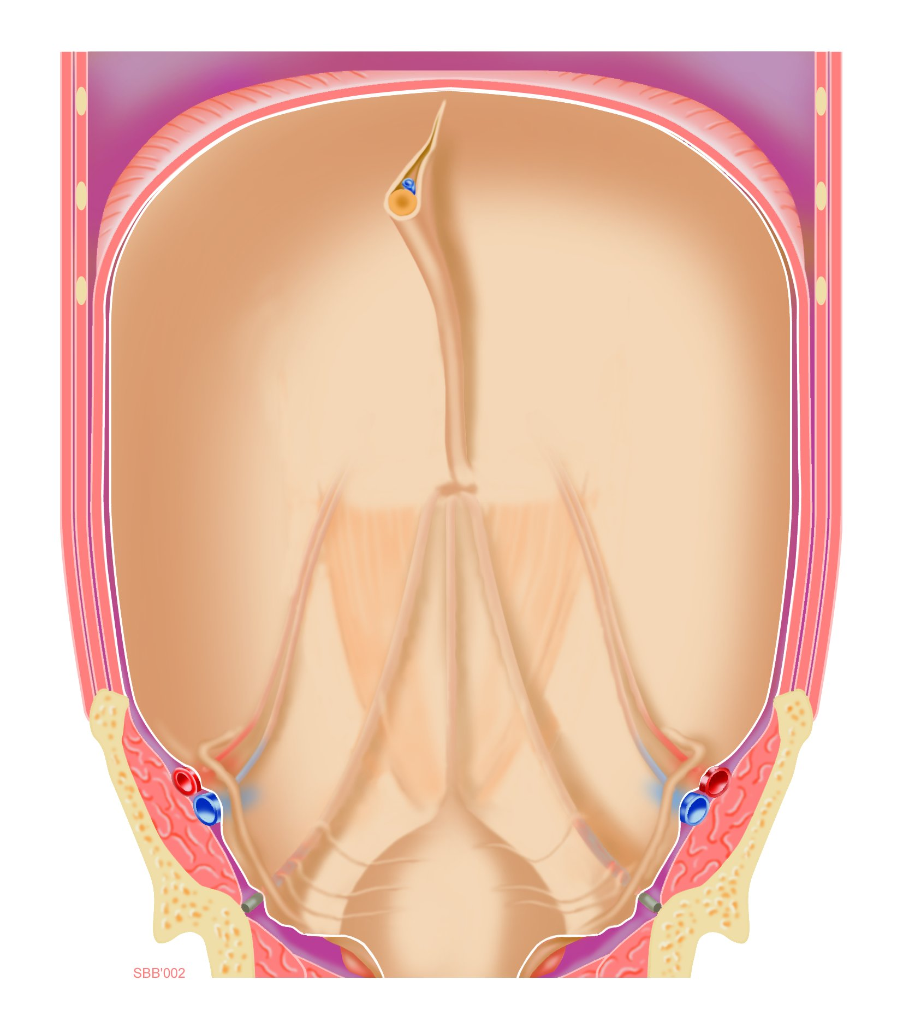
Falciform ligament ensheathing:
Round ligament of liver
Peritoneum
Lateral umbilical fold (overlying the inferior epigastric artery and vein)
Medial umbilical fold (overlying the medial umbilical ligament, which is the obliterated fetal umbilical artery)
Median umbilical fold (overlying the median umbilical ligament, which is a remnant of the fetal urachus)
Based on "The umbilical folds, no labels" at AnatomyTOOL.org by S. Bas Blankevoort, LUMC and O. Paul Gobée, LUMC, license: CC BY-NC-SA

