Slide 1


Presentation slide
Sobotta 1909 fig.569 -
Vessels of the rectum
(based on Sobotta 1909 fig.569 - Vessels of the male genitalia)
drawing: Johannes Sobotta and J. Playfair McMurrich. Artist: K. Hajek
image editing: dream_studio3
labels: O. Paul Gobée, MD, dept. Anatomy& Embryology, LUMC
license: Creative Commons Attribution ShareAlike

Slide 2
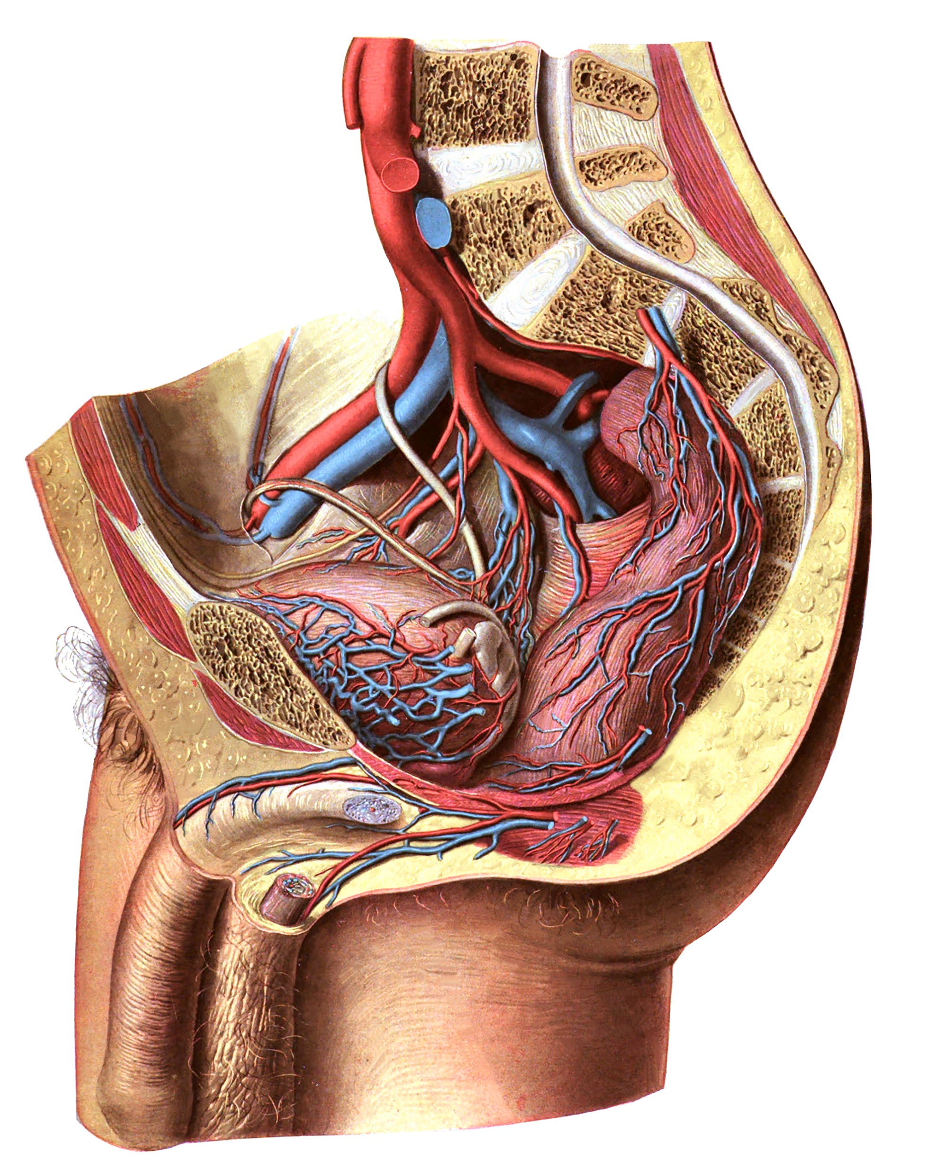
a./v. rectalis superior, superior rectal artery/vein
a./v. rectalis media (L/R), middle rectal artery/vein
a./v. rectalis inferior, inferior rectal artery/vein
1
2
2
3

