Slide 1
Presentation slide Sobotta 1909 fig.569 - Vessels of the male pelvis (based on Sobotta 1909 fig.569 - Vessels of the male genitalia)
drawing: Johannes Sobotta and J. Playfair McMurrich. Artist: K. Hajek
image editing: dream_studio3
labels: O. Paul Gobée, MD, dept. Anatomy& Embryology, LUMC
license: Creative Commons Attribution ShareAlike

Slide 2
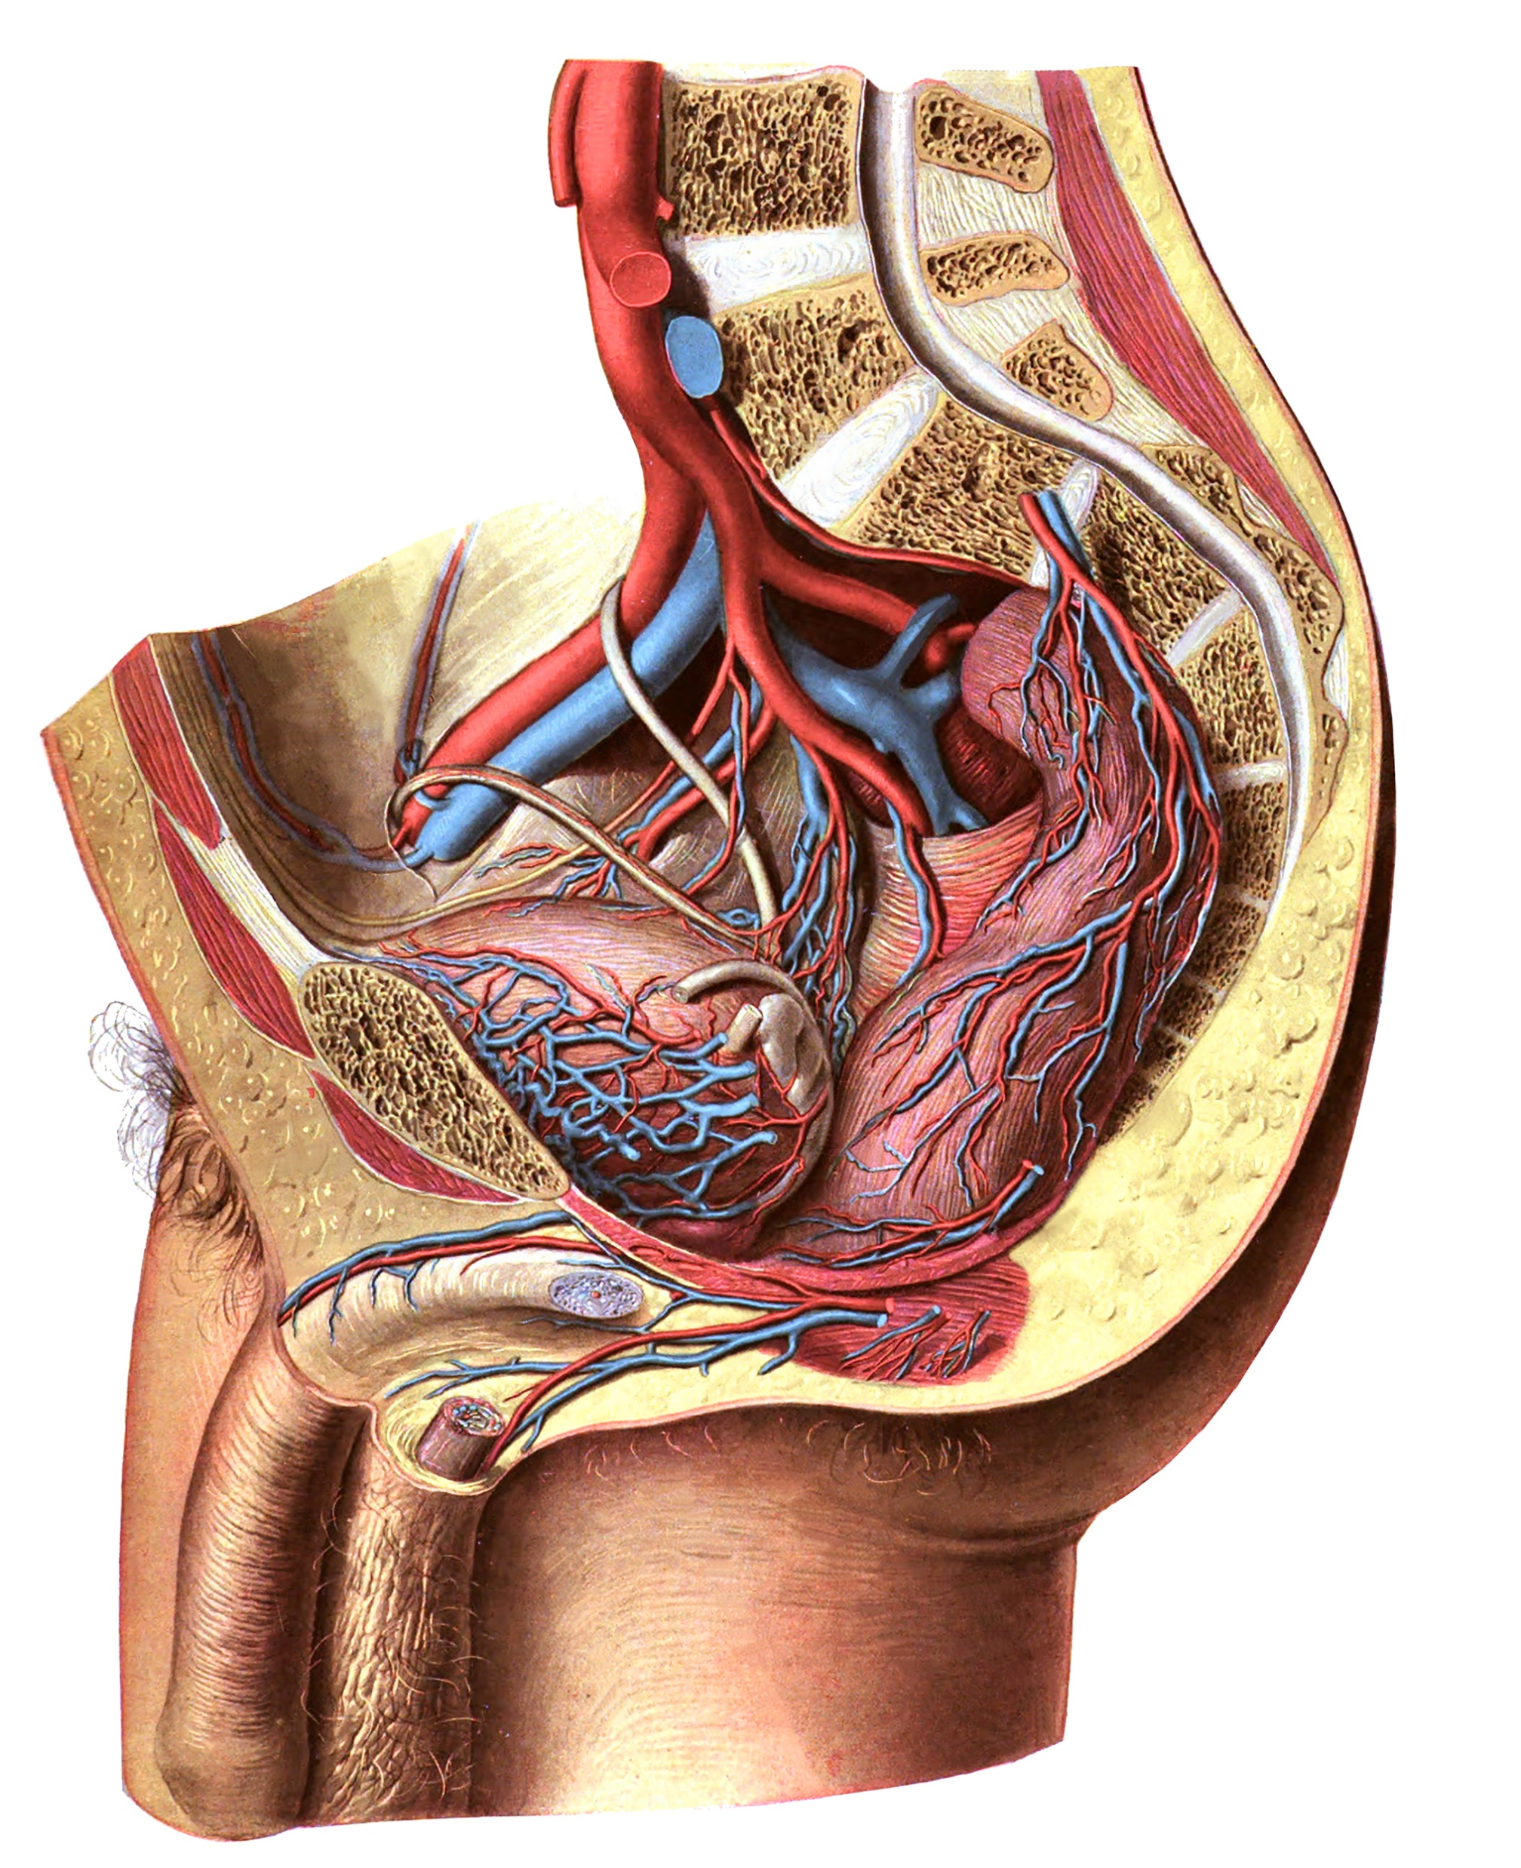
a. iliaca externa, external iliac artery
a. iliaca interna, internal iliac artery
a. umbilicalis, patent deel, umbilical artery, patent part
a. umbilicalis, geoblitereerd deel, umbilical artery, obliterated part
a./v. obturatoria, obturator artery/vein
a./v. vesicalis superior (L/R), superior vesical artery/vein (L/R)
a./v. vesicalis inferior (L/R), inferior vesical artery/vein (L/R)
a./v. rectalis superior, superior rectal artery/vein
a./v. rectalis media (L/R), middle rectal artery/vein
a./v. rectalis inferior, inferior rectal artery/vein
a./v. pudenda interna (L/R), internal pudendal artery/vein (L/R)
a./v. dorsalis penis dorsal artery/vein of penis
U Ureter (L/R)
DD Ductus deferens (L/R)
2
8
1
3
U
DD
11
5
4
6
9
DD
7
6
U
7
12
9
11
10

