Slide 1


Presentation slide
Sobotta 1909 fig. 716 - Lumbal plexus
drawing: Johannes Sobotta, J. Playfair McMurrich, K. Hajek, dream_studio3
labels: O. Paul Gobée, MD, dept. Anatomy& Embryology, LUMC
license: Creative Commons Attribution ShareAlike

Slide 2
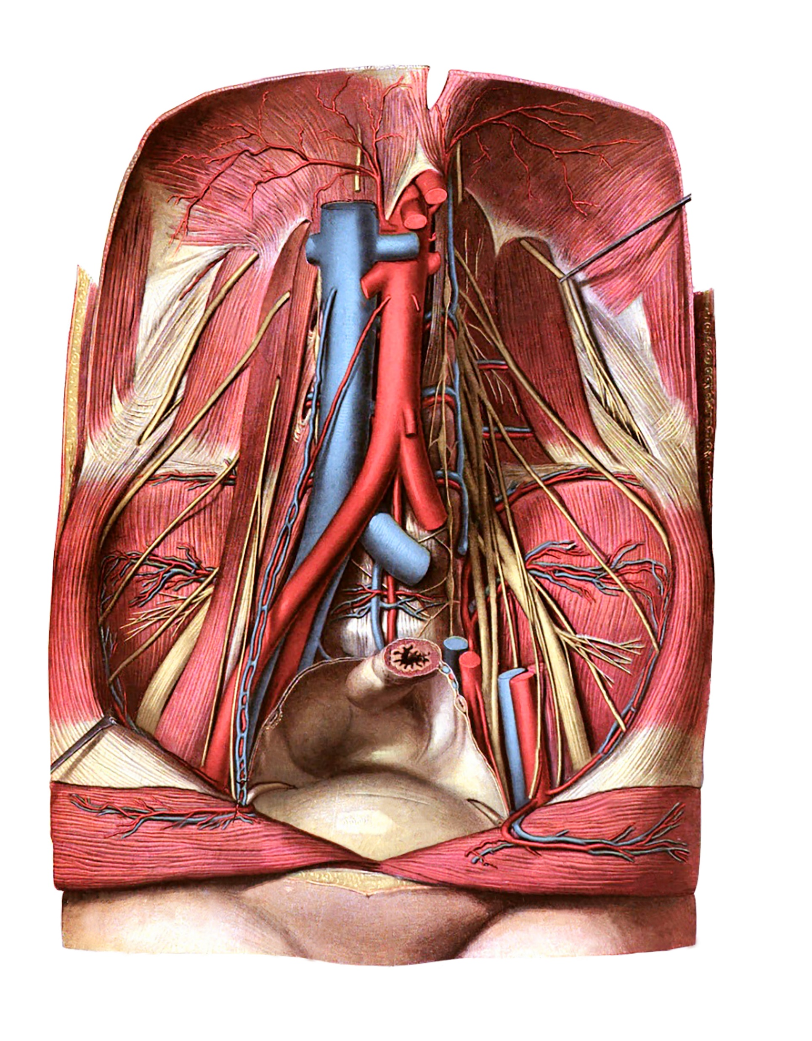
n. subcostalis
subcostal nerve
n. iliohypogastricus
iliohypogastric nerve
n. ilioinguinalis
ilioinguinal nerve
n. femoralis
femoral nerve
n. cutaneus femoris lateralis
lateral femoral cutaneous nerve
n. femoralis
femoral nerve
n. obturatorius
obturator nerve
n. genitofemoralis, ramus femoralis
femoral branch of genitofemoral nerve
n. genitofemoralis, ramus genitalis
genital branch of genitofemoral nerve
truncus lumbosacralis
lumbosacral trunk
n. obturatorius
obturator nerve

