Slide 1
Presentation slide Slagter - Drawing pancreas, duodenum and gallbladder
drawing: R. Slagter, NZIMBI, medical illustrator
labels: O. Paul Gobée, MD, dept. Anatomy& Embryology, LUMC
Based on original:
By R. Slagter, illustrator, source: https://anatomytool.org/content/slagter-drawing-pancreas-duodenum-and-gallbladder, license: CC BY NC SA
license: Creative Commons Attribution NonCommercial ShareAlike

Slide 2
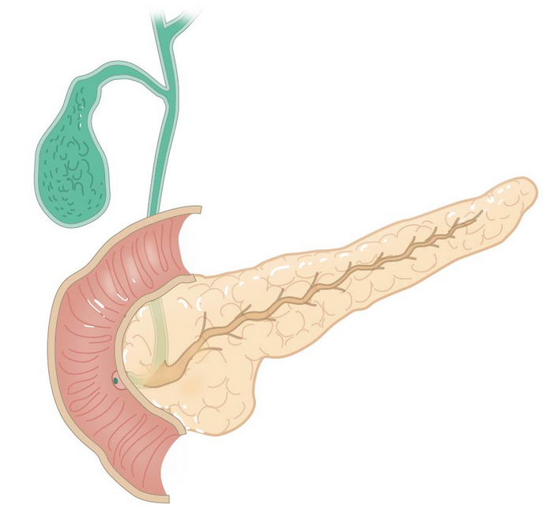
LEVER
LIVER
ductus cysticus
cystic duct
ductus hepaticus communis
common hepatic duct
ductus choledochus
bile duct
GALBLAAS
GALL BLADDER
ductus pancreaticus
pancreatic duct
papil van Vater
papilla duodeni major
major duodenal papilla
DUODENUM
ampulla hepatopancreatica (Vater)
hepatopancreatic ampulla

