Slide 1
Arteries of the intestines
drawing: Ron Slagter, NZMBI
labels: Paul Gobée, MD, anatomist

Slide 2
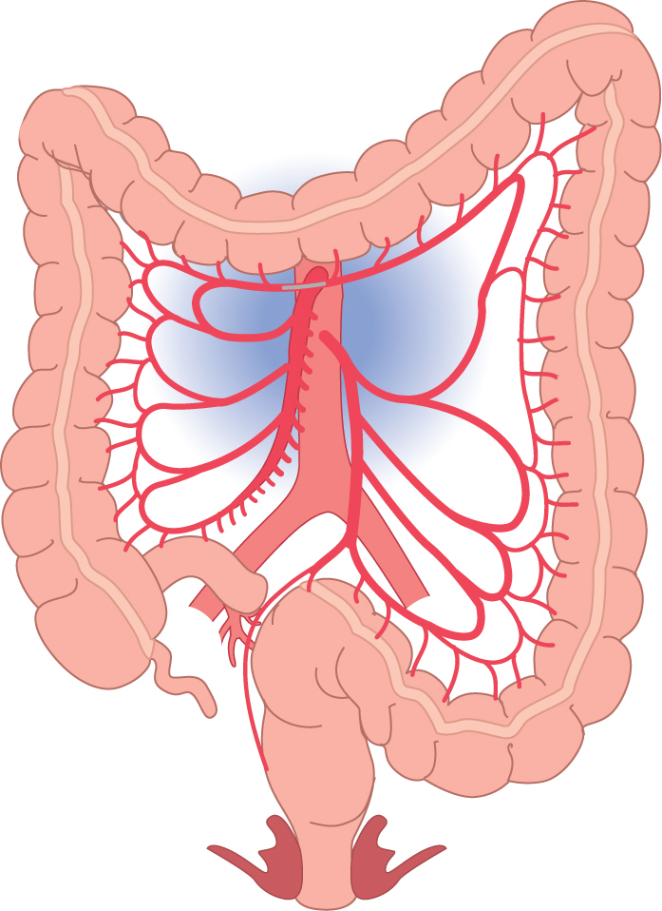
K
K
K
A: A. mesenterica superior/ Superior Mesenteric Artery (SMA)
B: Aa. jejunales/ Jejunal arteries
C: Aa. ileales/ Ileal arteries
D: A. ileocolica/ Ileocolic artery
E: A. colica dextra/ Right Colic artery (RCA)
F: A. colica media/ Middle Colic artery (MCA)
G: A. mesenterica inferior/ Inferior mesenteric artery (IMA)
H: A. colica sinistra/ Left Colic artery (LCA)
I: Aa. sigmoideae/ Sigmoid arteries
J: A. (ano)rectalis superior/ Superior (ano)rectal artery
K: A. marginalis coli (Drummond)/ Marginal artery
F
A
G
K
K
E
B
H
D
I
C
I
J
I
Arteries of the intestines
by Ron Slagter, NZMBI; Paul Gobée, MD, anatomist

