Slide 1
Presentation slide RCSI - Drawing Arteries and veins of kidney and adrenal gland
drawing: Royal College of Surgeons of Ireland
labels: O. Paul Gobée, MD, dept. Anatomy& Embryology, LUMC
license: Creative Commons Attribution NonCommercial ShareAlike

Slide 2
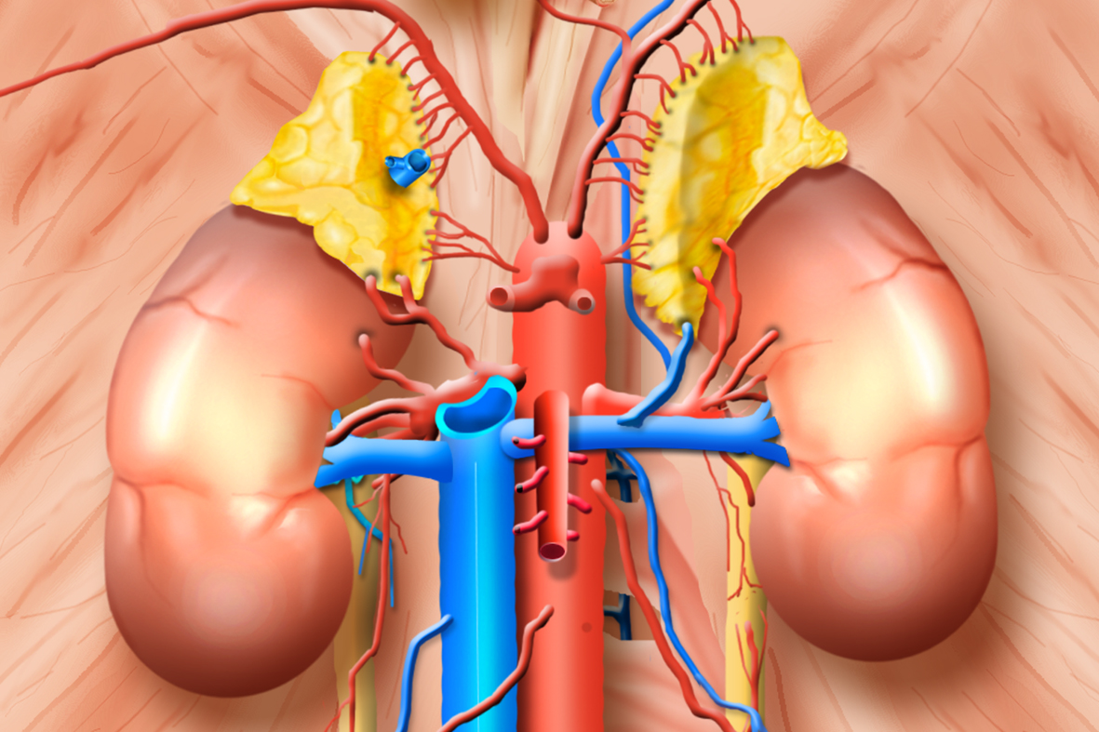
a. phrenica inferior
inferior phrenic artery
v. phrenica inferior sinistra
left inferior phrenic vein
aa. suprarenales superiores
superior suprarenal arteries
v. suprarenalis dextra
right suprarenal vein
a. suprarenalis media
middle suprarenal artery
a. suprarenalis inferior
inferior suprarenal artery
a. renalis dextra
right renal artery
v. suprarenalis sinistra
left suprarenal vein
v. renalis dextra
right renal vein
a. renalis sinistra
left renal artery
v. renalis sinistra
left renal vein
VCI
aorta
a./v. gonadalis dextra
right gonadal artery/vein
a./v. gonadalis sinistra
left gonadal artery/vein

Slide 3
Erratum
24 April 2024 corrected left inferior phrenic artery to left inferior phrenic vein

