Slide 1


Presentation slides
Human anus
You can use these slides for instance in presentations or to create custom images
Based on:
"Jmarchn - Drawing Human Anus - English labels" by Jordi Marchn, license: CC BY-SA
"Jmarchn - Drawing Human Anus - no labels" by Jordi Marchn, license: CC BY-SA
Original image by Jmarchn at:
https://commons.wikimedia.org/wiki/File:Human_anus-en.svg
Edits by:
O. Paul Gobée, dept. Anatomy & Embryology, LUMC
License: Creative Commons Attribution ShareAlike 4.0 Int.

Slide 2
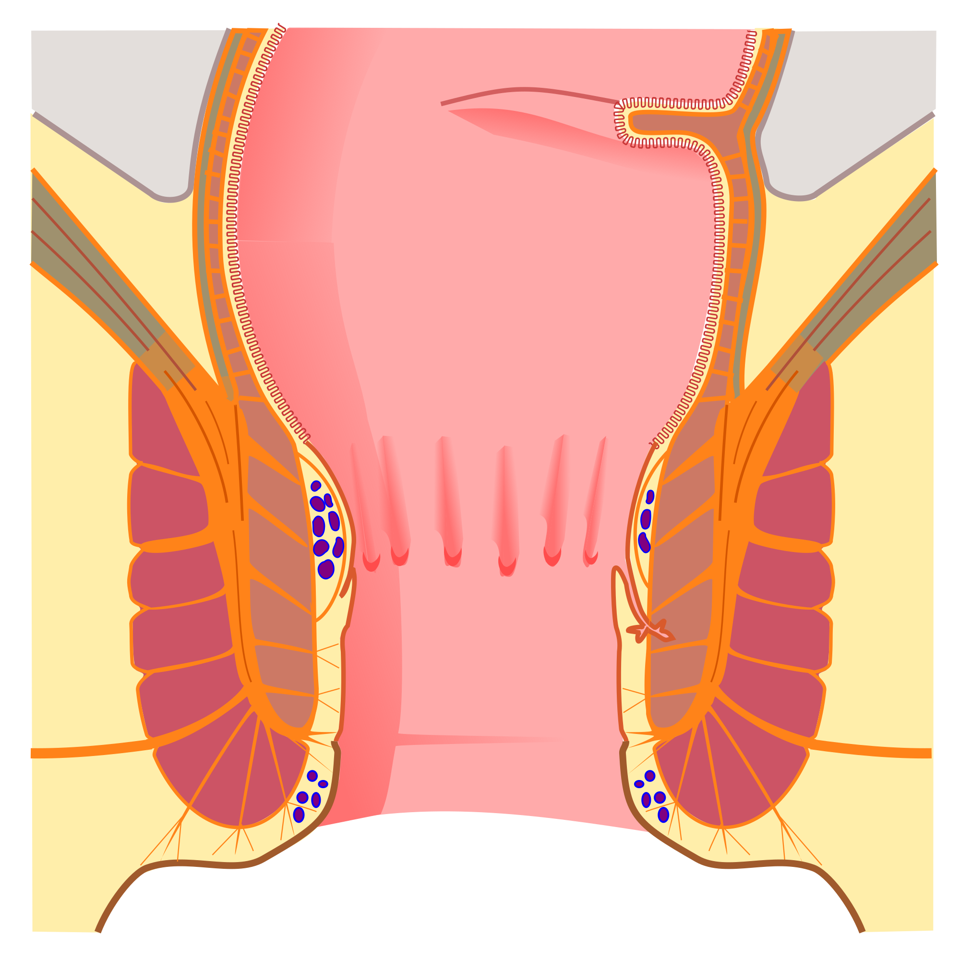
m. levator ani/
levator ani muscle
Rectum
Musculus sphincter ani internus /
Internal anal sphincter
Junctio anorectalis /
Anorectal junction
linea pectinata
(linea dentata)/
pectinate line
(dentate line)
Anus
Musculus sphincter ani externus /
External anal sphincter
anal canal
Source "Jmarchn - Drawing Human Anus - no labels" by Jordi Marchn, license: CC BY-SA

Slide 3
Rectum
Plexus venosus rectalis internus /
Internal rectal venous plexus
linea pectinata
(linea dentata)/
pectinate line
(dentate line)
Anus
Plexus venosus rectalis externus /
External rectal venous plexus
Source "Jmarchn - Drawing Human Anus - no labels" by Jordi Marchn, license: CC BY-SA

Slide 4
Separation at Pectinate line: connections to/from intestines ← versus→ connections to/from body wall
Arterial:
From inferior mesenteric artery
Venous:
To portal venous system
Lymphatic:
To internal iliac lymph nodes
Nervous:
Visceral motor: mixed sympathetic and parasympathetic
Visceral sensory: ‘accompanying parasympathetic fibres’ to S2-S4
linea pectinata
(linea dentata)/
pectinate line
(dentate line)
linea pectinata
(linea dentata)/
pectinate line
(dentate line)
Image source "Jmarchn - Drawing Human Anus - no labels" at AnatomyTOOL.org by Jordi Marchn, license: CC BY-SA
Edited by Paul Gobée, LUMC, based on Moore, Clinically Oriented Anatomy 8th ed. fig 6.59
Nervous:
Somatic motor and sensory
Lymphatic:
To superficial inguinal lymph nodes
Arterial:
From internal iliac artery
Venous:
To caval venous system

