Slide 1
Presentation slides Inguinal area, internal view, and entry points of inguinal and femoral hernia’s, labeled
Based on "Slagter Drawing Male inguinal area internal view - no labels“" at AnatomyTOOL.org by Ron Slagter, LUMC and O. Paul Gobée, LUMC, license: CC BY-NC-SA

Slide 2
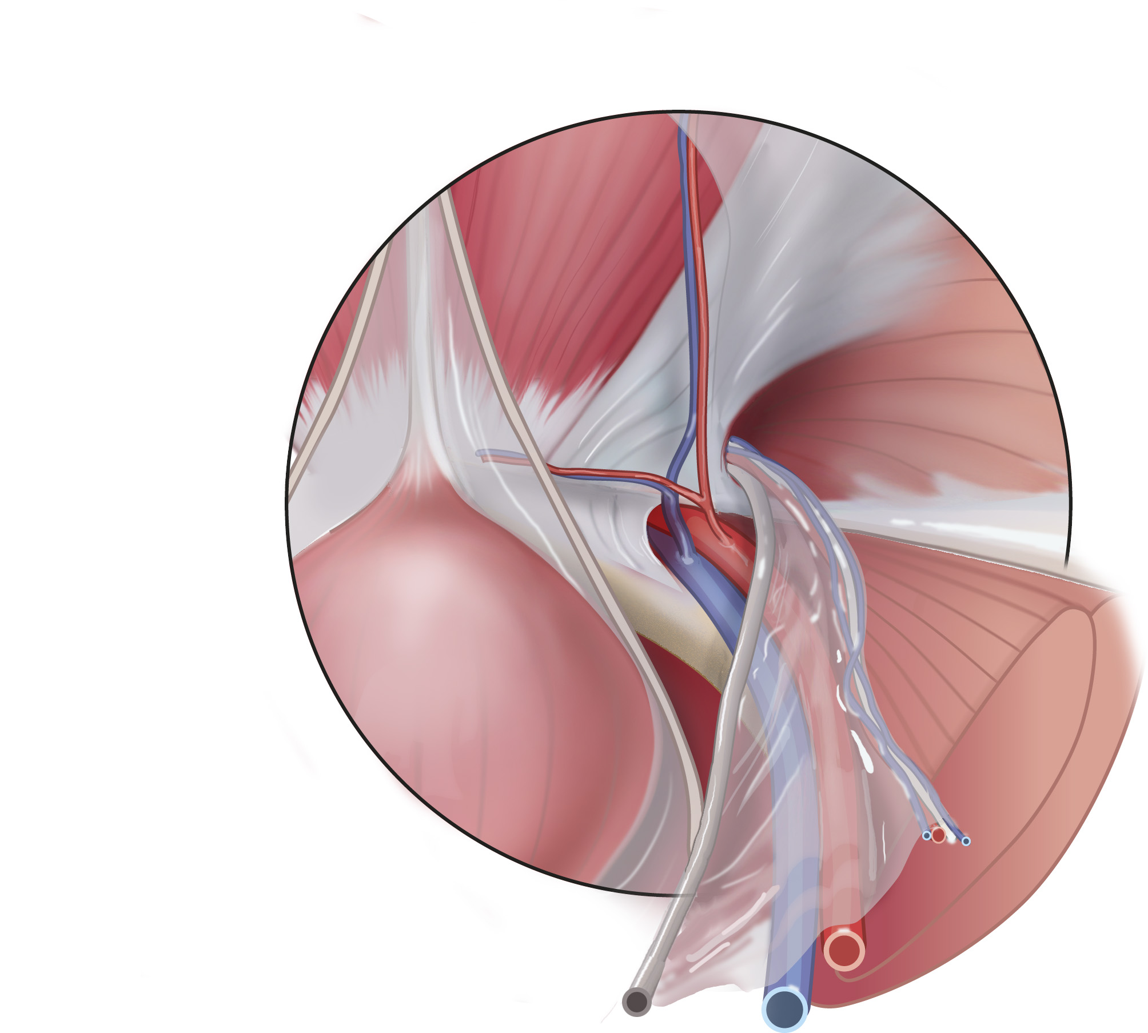
Rectus abdominis muscle
Inferior epigastric artery and vein
Medial umbilical ligament (remnant of fetal umbilical artery) & fold
Deep inguinal ring (entrance of inguinal canal)
Median umbilical ligament (remnant of urachus) & fold
Pubic branch of inferior epigastric artery and vein
Iliopubic tract
(lies parallel posterior – deep - to inguinal ligament)
Lacunar ligament (Gimbernat’s)
Pectineal ligament (Cooper’s)
Psoas major muscle
Iliacus muscle
Bladder
Testicular artery and vein
Genital branch of genitofemoral nerve
Pubic bone
Ductus deferens
External iliac artery and vein
Based on "Slagter Drawing Male inguinal area internal view - no labels“" at AnatomyTOOL.org by Ron Slagter, LUMC and O. Paul Gobée, LUMC, license: CC BY-NC-SA

Slide 3
Rectus abdominis muscle
Inferior epigastric artery and vein
Inguinal triangle
(Hesselbach’s)
entry place of medial inguinal hernia’s
Deep inguinal ring - entry place of lateral inguinal hernia’s
Lacunar ligament (Gimbernat’s)
Iliopubic tract
Femoral ring
(opening of femoral canal)
entry place of femoral hernia’s
Psoas major muscle
Iliacus muscle
Testicular artery and vein
Bladder
Pubic bone
Ductus deferens
External iliac artery and vein
Based on "Slagter Drawing Male inguinal area internal view - no labels“" at AnatomyTOOL.org by Ron Slagter, LUMC and O. Paul Gobée, LUMC, license: CC BY-NC-SA

Slide 4
Inguinal triangle
(Hesselbach’s)
entry place of medial inguinal hernia’s
Deep inguinal ring - entry place of lateral inguinal hernia’s
Femoral ring
(opening of femoral canal)
entry place of femoral hernia’s
Based on "Slagter Drawing Male inguinal area internal view - no labels“" at AnatomyTOOL.org by Ron Slagter, LUMC and O. Paul Gobée, LUMC, license: CC BY-NC-SA

