Slide 1
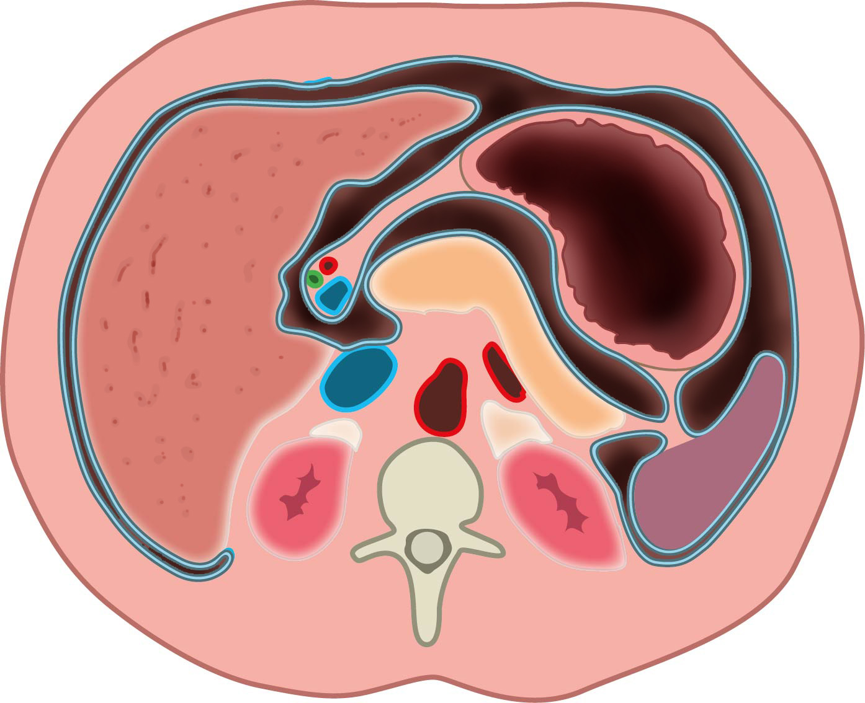
lig. hepatoduodenale
bursa omentalis
Maag
Lever
lig. gastrosplenicum
Pancreas
VCI
AS
Ao
Milt
Nier
Nier
lig. splenorenale
Aanzicht van inferieur
Based on "Leiden - Drawing Cross-section upper abdomen with peritoneal lining - no labels" by Ron Slagter, labels by O.Paul Gobée, license: CC BY-NC-SA

Slide 2
lig. hepatoduodenale
bursa omentalis
1
Links viscerale mediale rotatie (Mattox manueuvre) zonder nier
2
Links viscerale mediale rotatie (Mattox manueuvre) met nier
Maag
Lever
lig. gastrosplenicum
Pancreas
VCI
AS
Ao
Milt
Nier
Nier
lig. splenorenale
1
2
Aanzicht van inferieur
Based on "Leiden - Drawing Cross-section upper abdomen with peritoneal lining - no labels" by Ron Slagter, labels by O.Paul Gobée, license: CC BY-NC-SA

Slide 3
hepatoduodenal ligament
omental bursa
Stomach
Liver
gastrosplenic ligament
Pancreas
VCI
SA
Ao
Spleen
Kidney
Kidney
splenorenal ligament
View from inferior
Based on "Leiden - Drawing Cross-section upper abdomen with peritoneal lining - no labels" by Ron Slagter, labels by O.Paul Gobée, license: CC BY-NC-SA

Slide 4
hepatoduodenal ligament
omental bursa
1
Left visceral medial rotation (Mattox manueuvre) without kidney
2
Left visceral medial rotation (Mattox manueuvre) with kidney
Stomach
Liver
gastrosplenic ligament
Pancreas
VCI
SA
Ao
Spleen
Kidney
Kidney
splenorenal ligament
1
2
View from inferior
Based on "Leiden - Drawing Cross-section upper abdomen with peritoneal lining - no labels" by Ron Slagter, labels by O.Paul Gobée, license: CC BY-NC-SA

