Slide 1
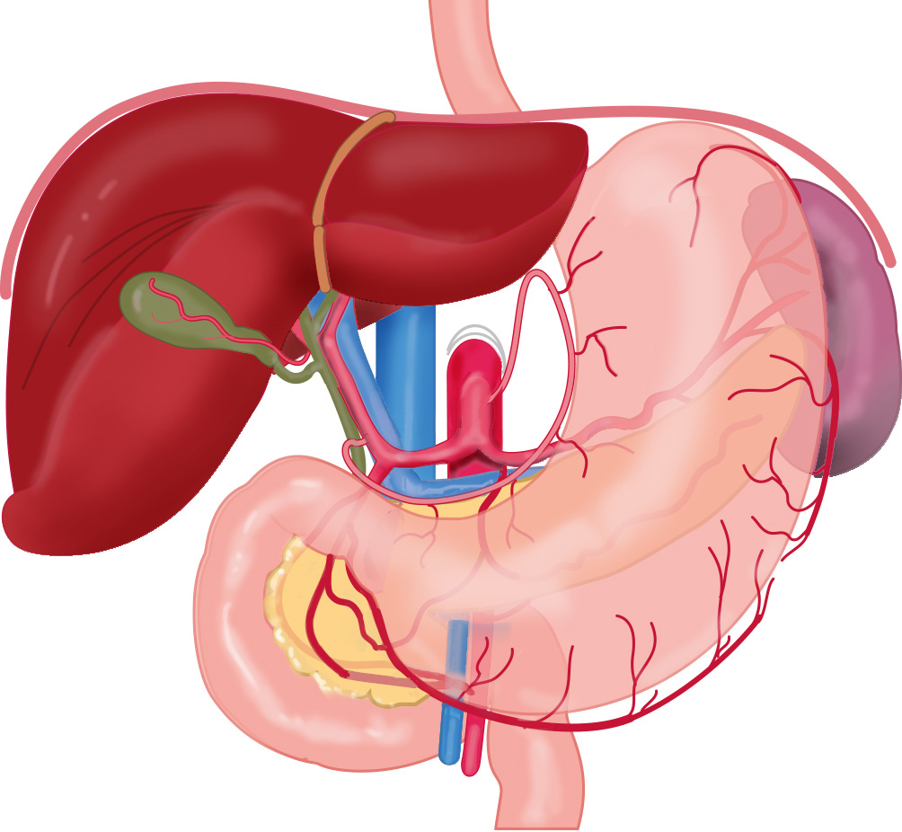
SGA
LGA
PHA
CT
SA
LGOA
GDA
CHA
RGA
RGOA
"Leiden - Drawing Arteries of the stomach - English labels" by Ron Slagter and O. Paul Gobée, LUMC, license: CC BY-NC-SA

Slide 2
CHA = Common hepatic artery, a. hepatica communis CT = Celiac trunk, truncus coeliacus
GDA = Gastroduodenal artery, a. gastroduodenalis
LGA = Left gastric artery, a. gastrica sinistra
LGOA = Left gastroomental/gastroepiploic artery, a. gastroomentalis/gastroepiploica sinistra
PHA = Proper hepatic artery, a. hepatica propria
RGA = Right gastric artery, a. gastrica dextra
RGOA = Right gastroomental/gastroepiploic artery, a. gastroomentalis/gastroepiploica dextra
SA = Splenic artery, a. splenica/lienalis
SGA = Short gastric arteries, aa. gastricae breves

