Slide 1
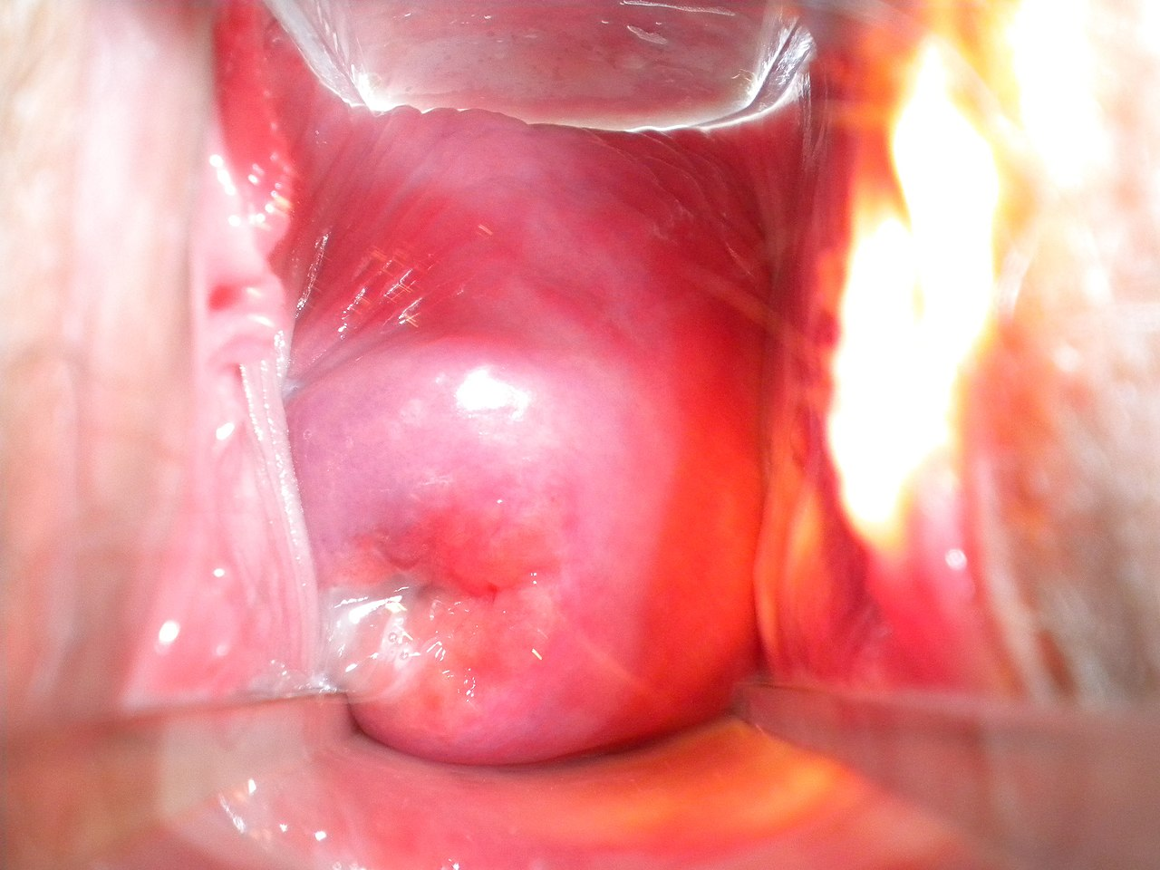
Pars anterior fornicis vaginae /
Anterior part of fornix of vagina
Portio vaginalis cervicis / Vaginal part of cervix
Pars lateralis fornicis vaginae / Lateral part of fornix of vagina
Pars lateralis fornicis vaginae / Lateral part of fornix of vagina
Vaginal wall
Ostium uteri / External cervical os
Pars posterior fornicis vaginae /
Posterior part of fornix of vagina

