Slide 1
Photo internal view female inguinal region, labeled
By O. Paul Gobée, LUMC, license: CC BY-NC-SA

Slide 2
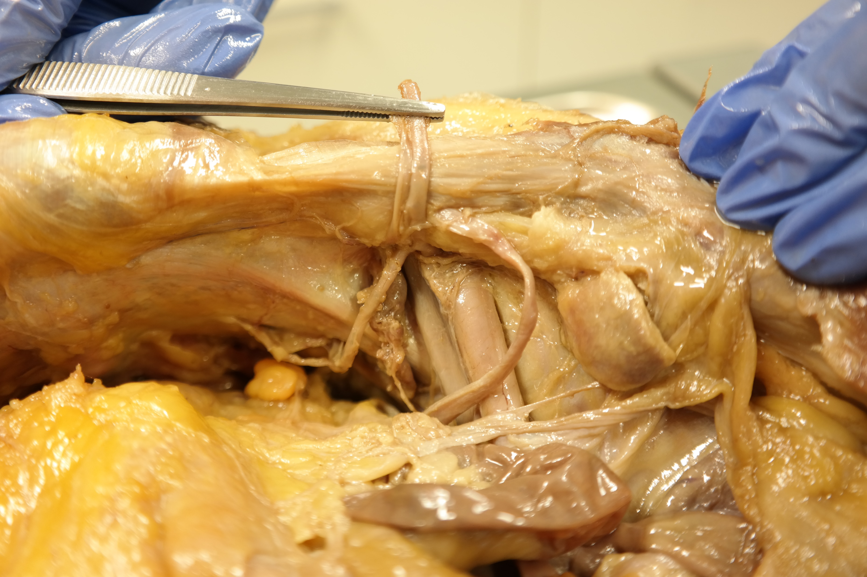
inferior epigastric vein and artery
pubic bone
deep inguinal ring
lacunar ligament (Gimbernat’s)
iliopubic tract
pectineal ligament (Cooper’s)
round ligament of uterus
obturator branch of inferior epigastric artery (corona mortis)
external iliac artery
femoral ring, entrance of femoral canal, holding lymphe node
external iliac vein

