Slide 1
Presentation slide Subject
photo: prof. dr. T. Wiggers, surgeon
labels: O. Paul Gobée, MD, dept. Anatomy& Embryology, LUMC
license: Creative Commons Attribution NonCommercial ShareAlike

Slide 2
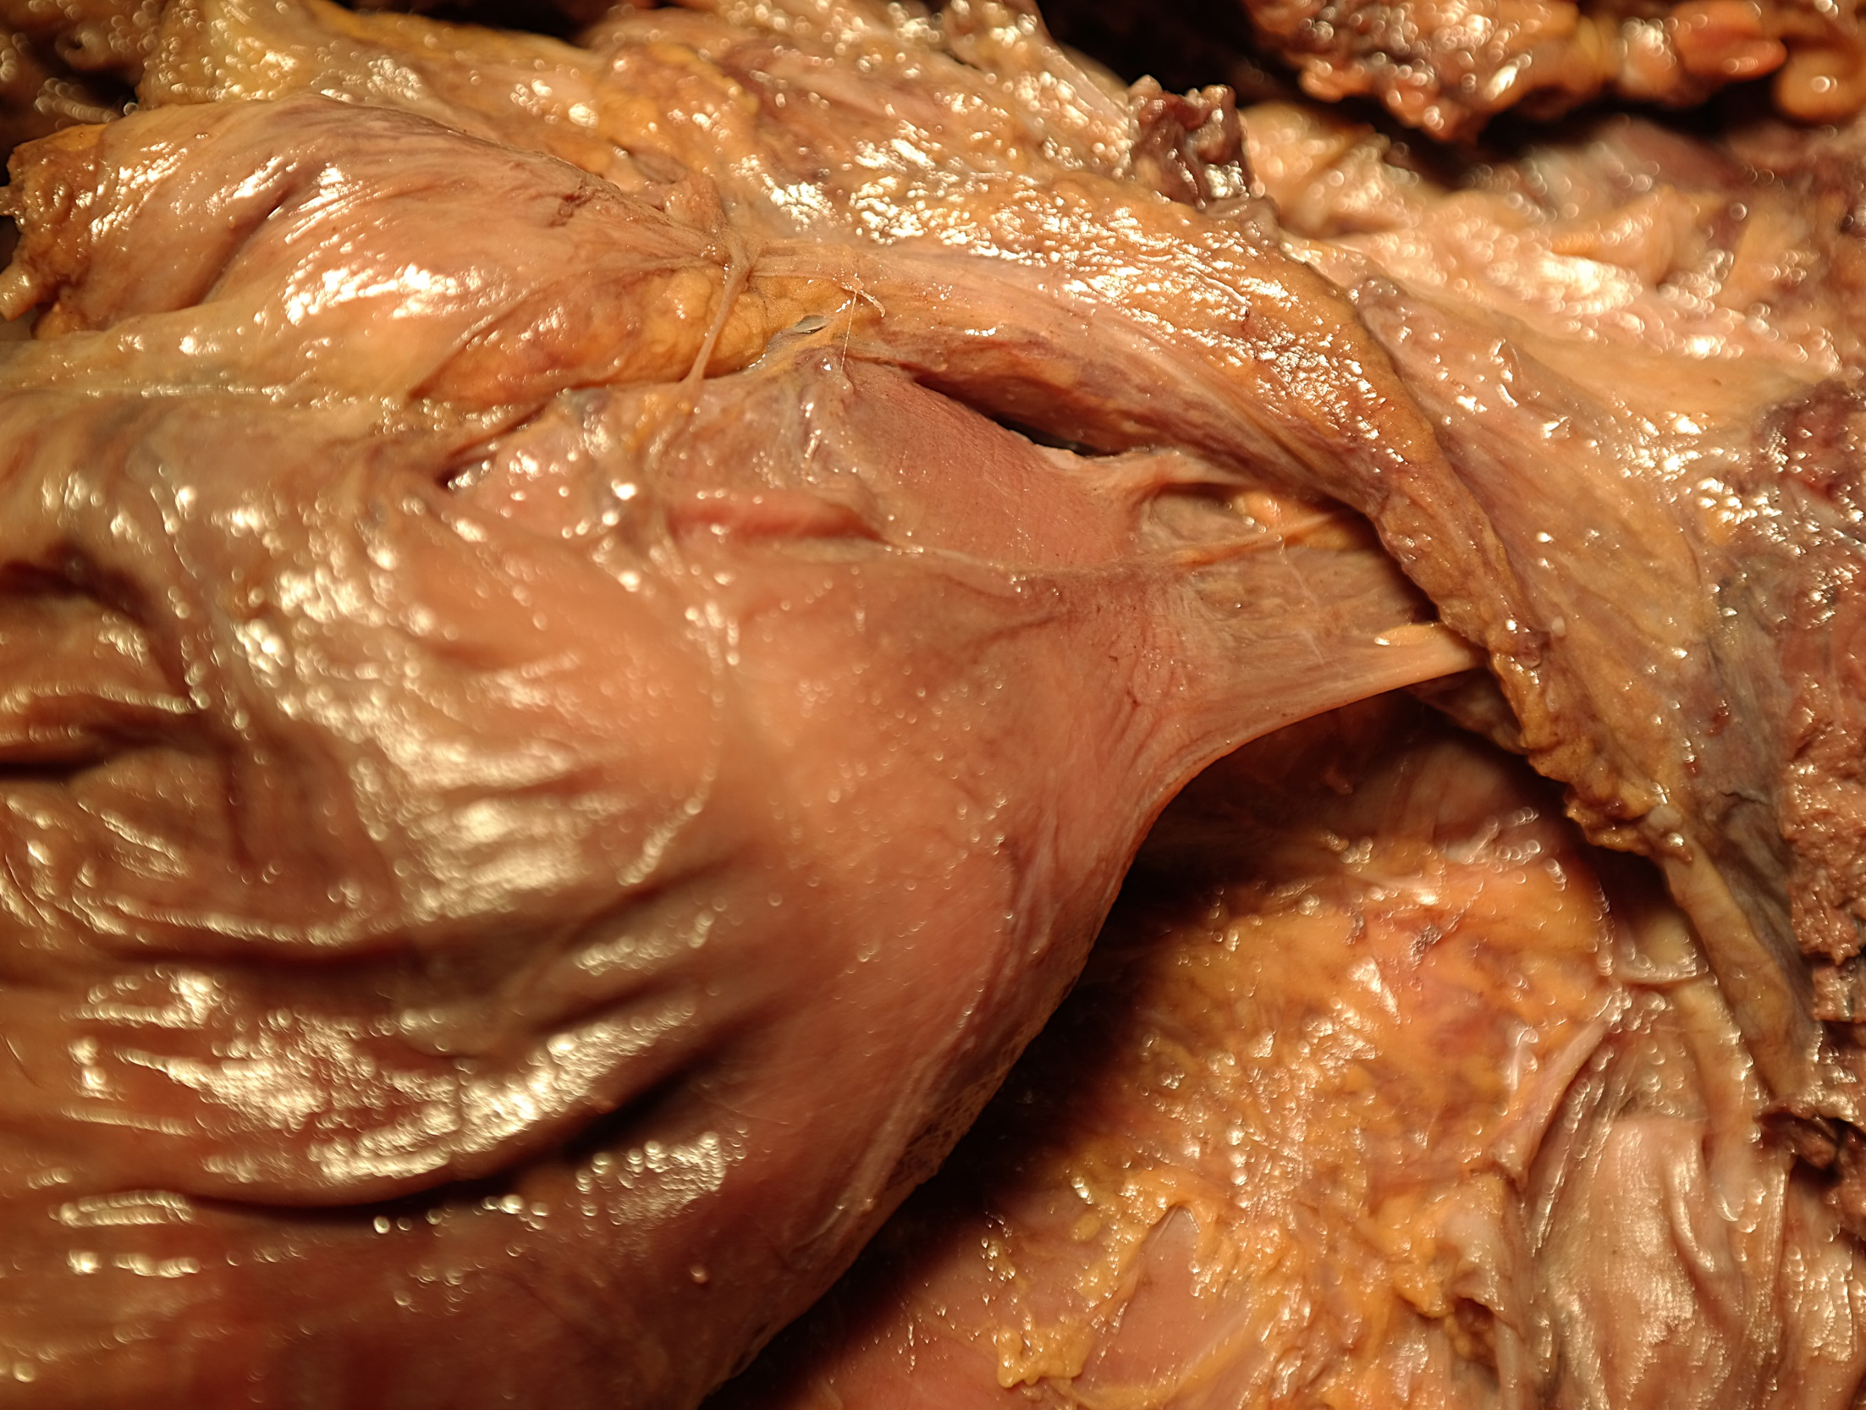
Treitz’ ligament
duodenum
photo: prof. dr. T. Wiggers

