Slide 1
Pelvis plastination specimens by Kees Maas PART 2 – plates 14 - 35
A series of photographs of pelvis plastination specimens created for training courses for gynaecologists and dissected by:
Dr. Kees (C.P.) Maas, MD, PhD †
Prof. Marco C. DeRuiter, PhD, professor of Clinical and Experimental Anatomy
Photo’s: Jan Lens, medical photographer
This presentation file: O. Paul Gobée, MD, senior lecturer of anatomy
These specimens and photographs are now also being used for anatomy labs for medical students.
This presentation is dedicated to the memory of doctor Kees Maas, who was strongly committed to the improval of nerve sparing oncological surgery in the pelvis. https://www.medischcontact.nl/nieuws/laatste-nieuws/artikel/alles-wat-ik-nu-nog-doe-moet-zin-hebben.htm
Dept. Anatomy & Embryology
Leiden University Medical Center,
Leiden, Netherlands
Licensed by LUMC under Creative Commons Attribute NonCommercial ShareAlike 4.0 Int.

Slide 2
Corrections and changes
19 Jan. 2023 Added plates 34 and 35 re. specimen 66
Licensed by LUMC under Creative Commons Attribute NonCommercial ShareAlike 4.0 Int.

Slide 3
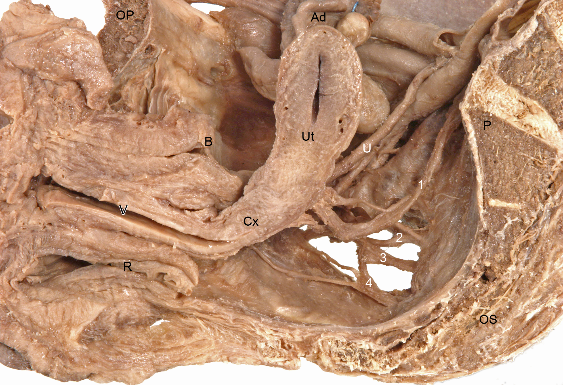
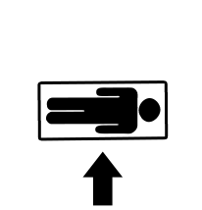
14
Spec. 67
Plate 14 (view from medial to lateral)
OP os pubis
P promontorium
OS os sacrum
R rectum
B bladder
V vagina
Cx cervix
Ut uterus
U ureter
Ad adnex
n. hypogastricus
n. sacralis ramus anterior S2
n. sacralis ramus anterior S3
n. sacralis ramus anterior S4
Licensed by LUMC under Creative Commons Attribute NonCommercial ShareAlike 4.0 Int.

Slide 4
15
Spec. 67
1
Plate 15 (detail of 14)
n. hypogastricus
n. sacralis ramus anterior S2
n. sacralis ramus anterior S3
n. sacralis ramus anterior S4
pelvic splanchnic nerve
plexus hypogastricus inferior (pelvic plexus)
n. pudendus
n. levator ani
2
3
4
Licensed by LUMC under Creative Commons Attribute NonCommercial ShareAlike 4.0 Int.

Slide 5
16
Spec. 67
PHI
PHI
Plate 16 (detail of 15, view slightly more from postero superior)
V vagina
Cx cervix
Ut uterus
U ureter
PHI plexus hypogastricus inferior
aU arteria uterina
aV arteria vaginalis
Licensed by LUMC under Creative Commons Attribute NonCommercial ShareAlike 4.0 Int.

Slide 6
17
Spec. 67
10
Plate 17 (view from posterior lateral)
OS os sacrum
AN anus
LM labium majorum
tuber ischiadicum
spina ischiadica
lig. sacrospinale
lig. sacrotuberale
m. levator ani
Licensed by LUMC under Creative Commons Attribute NonCommercial ShareAlike 4.0 Int.

Slide 7
18
Spec. 67
Plate 18 (detail of 17)
OS os sacrum
AN anus
tuber ischiadicum
spina ischiadica
lig. sacrospinale
lig. sacrotuberale
m. levator ani
m. sphincter ani externus
Licensed by LUMC under Creative Commons Attribute NonCommercial ShareAlike 4.0 Int.

Slide 8
19
Spec. 67
Graphpad
Plate 19 (detail of 18)
n. pudendus
n. ischiadicus
nn. anales inferiores (rami anales inferiores)
nn. perineales (rami perineales)
Licensed by LUMC under Creative Commons Attribute NonCommercial ShareAlike 4.0 Int.

Slide 9
20
Spec. 67
Plate 20 (view from below, view on perineum)
OS os sacrum
TI tuber ischiadicum
AN anus
LM labium majorum
Lm labium minorum
OV ostium vaginae
GC glans clitoris
m. ischiocavernosus
m. transversus perinei superficialis
nn. labiales posteriores
Licensed by LUMC under Creative Commons Attribute NonCommercial ShareAlike 4.0 Int.

Slide 10
21
Spec. 67
Plate 21 (detail of 20)
OS os sacrum
TI tuber ischiadicum
AN anus
LM labium majorum
Lm labium minorum
OV ostium vaginae
GC glans clitoris
m. ischiocavernosus
m. transversus perinei superficialis
nn. labiales posteriores
Licensed by LUMC under Creative Commons Attribute NonCommercial ShareAlike 4.0 Int.

Slide 11
22
Spec. 67
Plate 22 (viewing into pelvic cavity from superior)
OP os pubis
LM labium majorum
B bladder
Ut uterus
U ureter
Ad adnex
P promontorium
Licensed by LUMC under Creative Commons Attribute NonCommercial ShareAlike 4.0 Int.

Slide 12
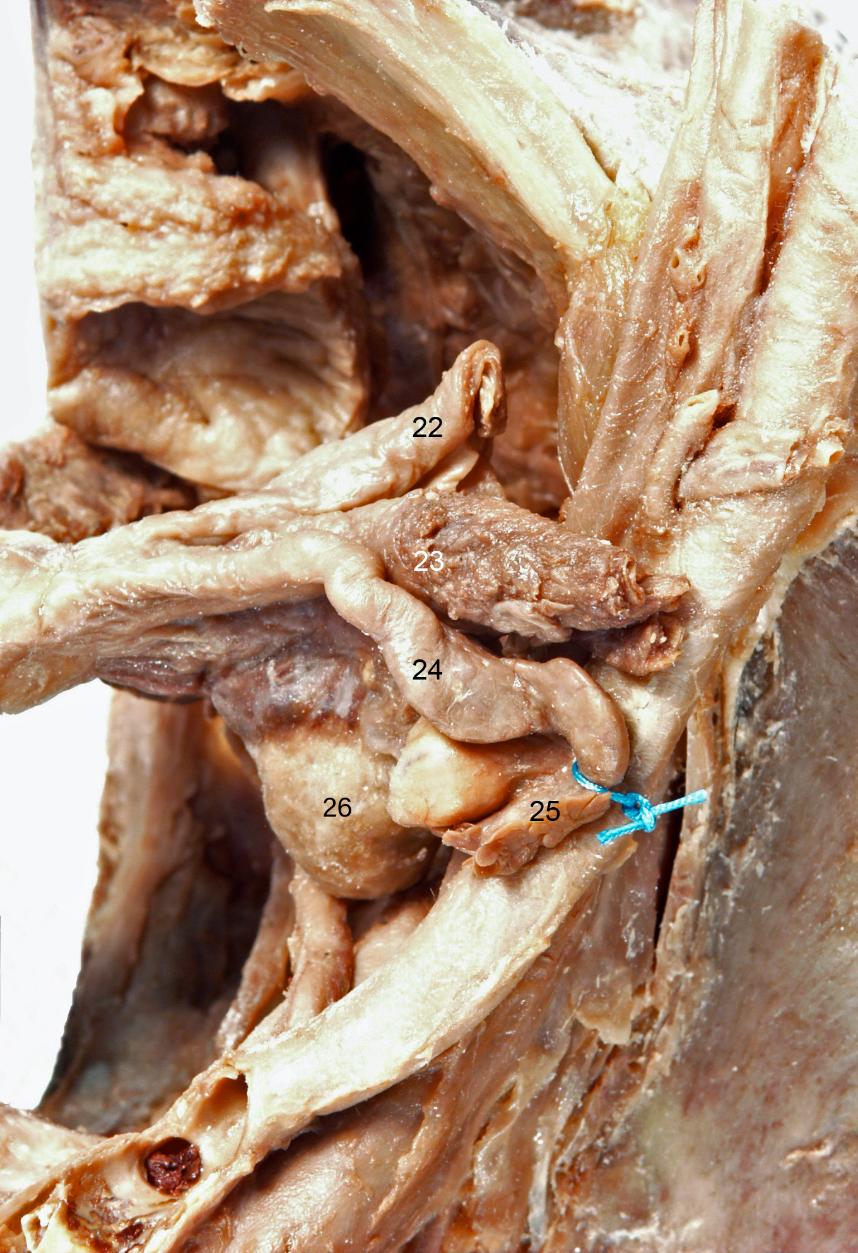
23
Spec. 67
Plate 23 (detail of 22)
lig. teres uteri (lig. rotundum)
lig. suspensorium ovarii (lig. infundibulopelvicum )
tuba uterina
fimbriae tubae uterinae
ovarium
Licensed by LUMC under Creative Commons Attribute NonCommercial ShareAlike 4.0 Int.

Slide 13
24
Spec. 67
Plate 24 (as 23, slightly more from posterior, focus on depth)
n. hypogastricus
n. levator ani
Licensed by LUMC under Creative Commons Attribute NonCommercial ShareAlike 4.0 Int.

Slide 14
25
Spec. 67
Plate 25 (view from medial to lateral)
OP os pubis
LM labium majorum
CC corpus cavernosum clitoridis
B bladder
Ut uterus
V vagina
R rectum
P promontorium
Licensed by LUMC under Creative Commons Attribute NonCommercial ShareAlike 4.0 Int.

Slide 15
26
Spec. 67
Plate 26 (view from front)
B bladder
OP os pubis
LA m. levator ani
CC corpus cavernosum clitoridis
CrC crus clitoridis
DC arteria and n. dorsalis clitoridis
NC nn. cavernosi clitoridis
Ut uterus
V vagina
Licensed by LUMC under Creative Commons Attribute NonCommercial ShareAlike 4.0 Int.

Slide 16
27
aU
Spec. 70
aVS
Plate 27 (view from anterior/superior)
Adnexes were removed.
OP os pubis
B bladder
Ut uterus
U ureter
R rectum
Pa pararectal space
aU a. umbilicalis
aVS a. vesicalis superior
plexus hypogastricus superior
nervus hypogastricus
Nervus hypogastricus lies against/ in lig. rectouterinum, laterally of it.
Licensed by LUMC under Creative Commons Attribute NonCommercial ShareAlike 4.0 Int.

Slide 17
28
Spec. 70
Plate 28 (detail of 27)
B bladder
Ut uterus
U ureter
R rectum
plexus hypogastricus superior
nervus hypogastricus
n. splanchnicus pelvicus (at yellow mark)
Nervus hypogastricus lies against/ in lig. rectouterinum, laterally of it.
Licensed by LUMC under Creative Commons Attribute NonCommercial ShareAlike 4.0 Int.

Slide 18
29
Spec. 71
Plate 29 (view from anterior/superior)
uterus
ovaria
rectum
bladder
os pubis/ symphysis
promontorium
Licensed by LUMC under Creative Commons Attribute NonCommercial ShareAlike 4.0 Int.

Slide 19
30
Spec. 71
Plate 30 (detail of 29)
uterus
ovarium
rectum
bladder (not labelled on this photo)
os pubis/ symphysis
promontorium
lig. ovarii proprium
tuba uterinae
lig. suspensorium ovarii (lig. Infundibulopelvicum)
mesosalpinx
mesovarium
lig. latum. uteri (this part is also mesometrium)
lig. teres uteri (lig. rotundum)
Licensed by LUMC under Creative Commons Attribute NonCommercial ShareAlike 4.0 Int.

Slide 20
31
Spec. 71
LM
Lm
RO
RO
TI
TI
Plate 31 (view from inferior)
OS os sacrum
TI tuber ischiadicum
RO ramus ossis pubis
LM labium majorum
Lm labium minorum
OS
Licensed by LUMC under Creative Commons Attribute NonCommercial ShareAlike 4.0 Int.

Slide 21
32
Spec. 71
Plate 32 (detail of 31)
membrana perinei / diafragma urogenitale, m. transversus perinei profundus
m. gluteus major
m. sphincter ani externus, pars superficialis
m. sphincter ani externus, pars profundus
m. levator ani - m. pubococcygeus
Licensed by LUMC under Creative Commons Attribute NonCommercial ShareAlike 4.0 Int.

Slide 22
33
Spec. 71
Plate 33 (as 32, view more from posterior)
m. sphincter ani externus, pars superficialis
m. sphincter ani externus, pars profundus
m. levator ani - m. pubococcygeus
lig. anococcygeum
m. levator ani - m. puborectalis
n. pudendus
Licensed by LUMC under Creative Commons Attribute NonCommercial ShareAlike 4.0 Int.

Slide 23
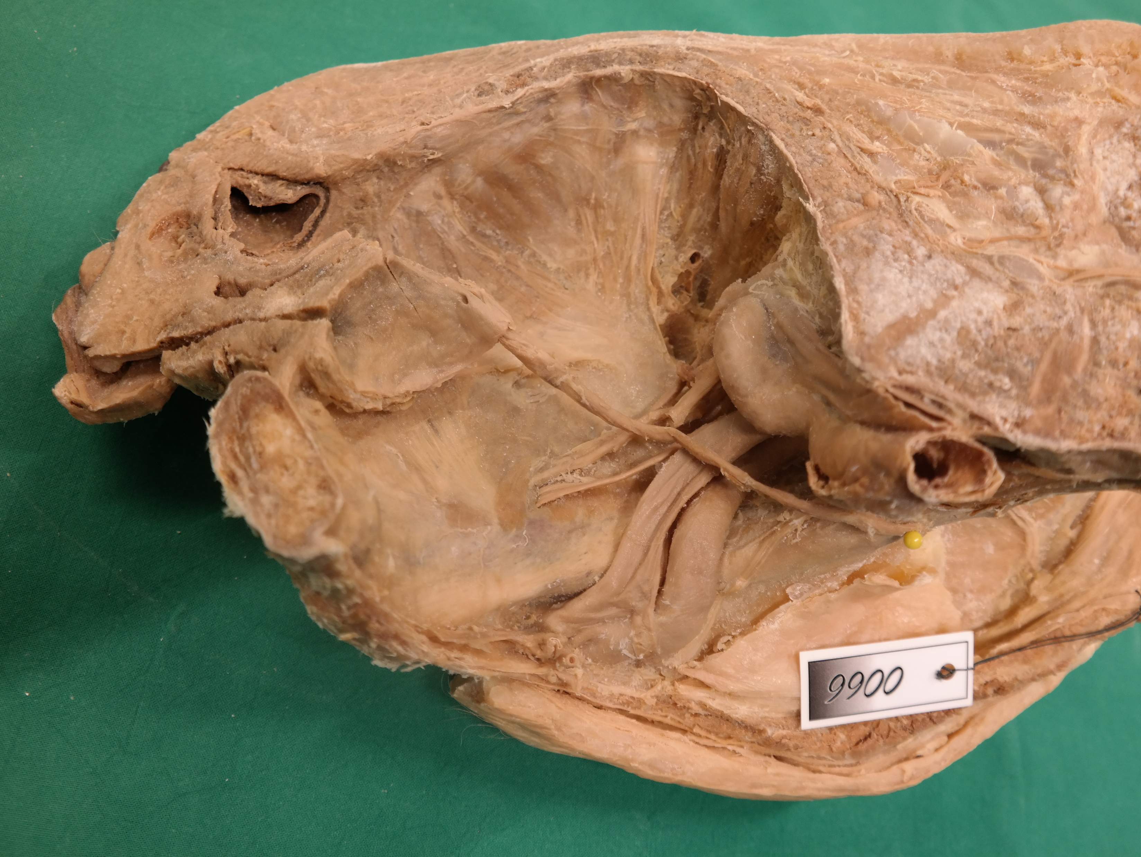
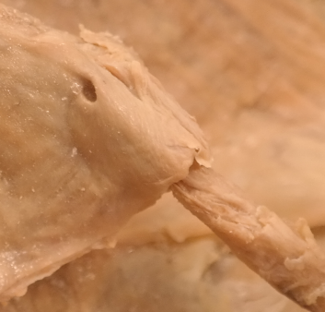
34
Spec. 66
Ureter
Ostium ureteris in bladder
2
1
Licensed by LUMC under Creative Commons Attribute NonCommercial ShareAlike 4.0 Int.

Slide 24
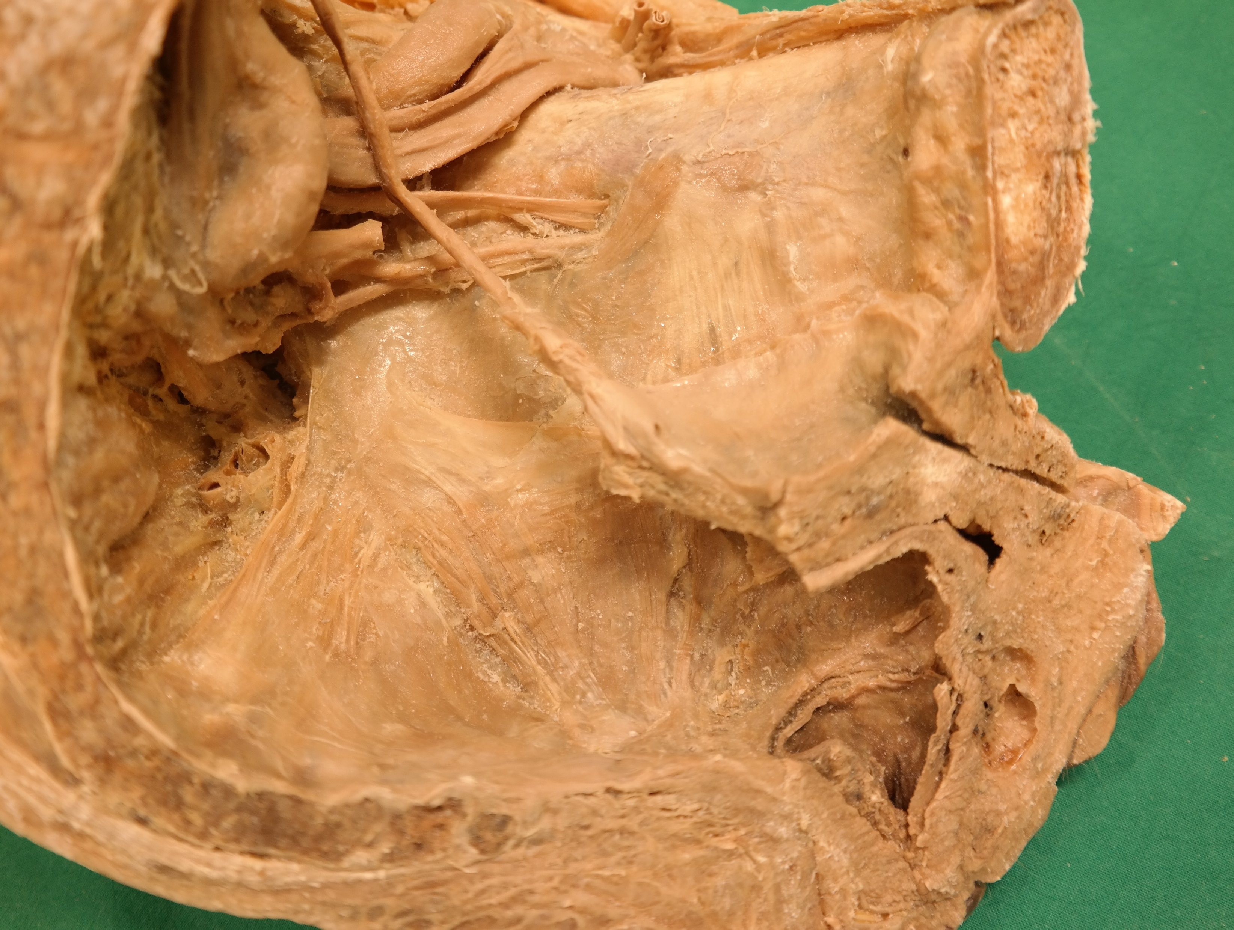
35
Spec. 66
1
8
7
9
2
3
6
Os pubis
M. obturatorius internus
Arcus tendineus of m. levator ani
M. levator ani
M. coccygeus
Posterior border of m. coccygeus, entrance of pudendal canal
Canalis obturatorius
N. obturatorius
A. obturatoria
4
5
Licensed by LUMC under Creative Commons Attribute NonCommercial ShareAlike 4.0 Int.

Slide 25
This presentation is licensed by Leiden University Medical Center under
Creative Commons Attribute NonCommercial ShareAlike 4.0 International
license
The unlabeled photo’s are available at https://anatomytool.org
Frame is A4 print outside size

