Slide 1
Presentation slide Drawing Parts of the Stomach
drawing: R. Slagter, NZIMBI, medical illustrator
labels: O. Paul Gobée, MD, dept. Anatomy& Embryology, LUMC
license: Creative Commons Attribution NonCommercial ShareAlike

Slide 2
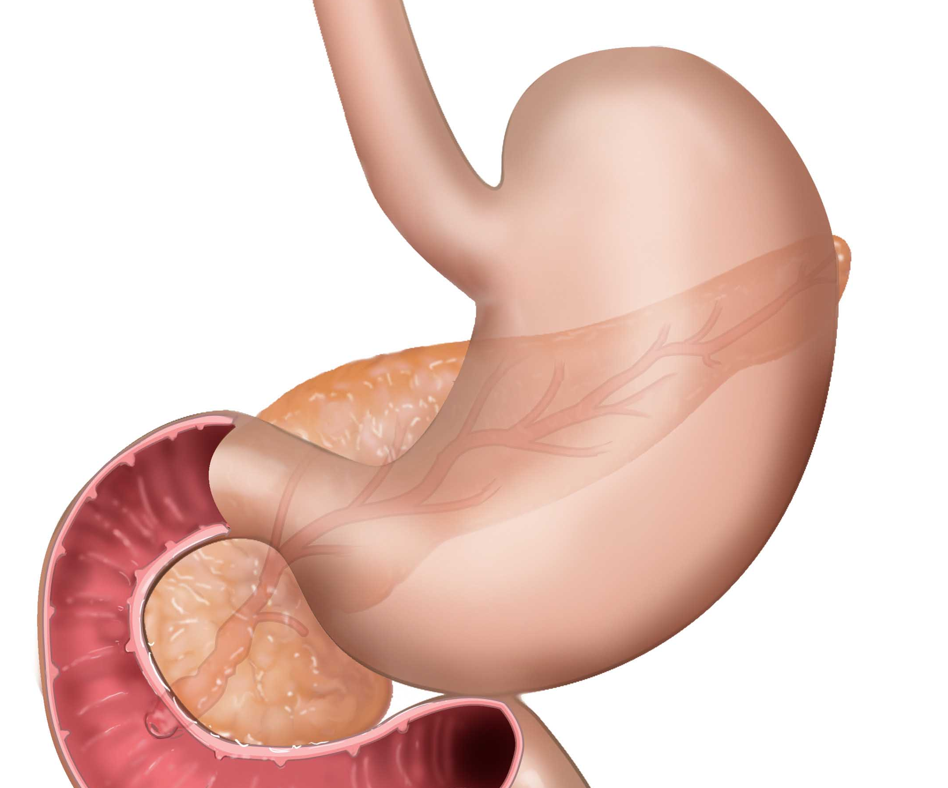
Incisura cardialis
Cardiac notch
Fundus
Cardia
Curvatura minor
Lesser curvature
Incisura angularis
Angular incisure
Corpus
Pylorus
Antrum
Curvatura major
Greater curvature

