Slide 1

Leiden - Photo Portal vein and contributing veins (dissection) - English, Latin, Dutch labels
By O. Paul Gobée, LUMC, license: CC BY-NC-SA

Slide 2
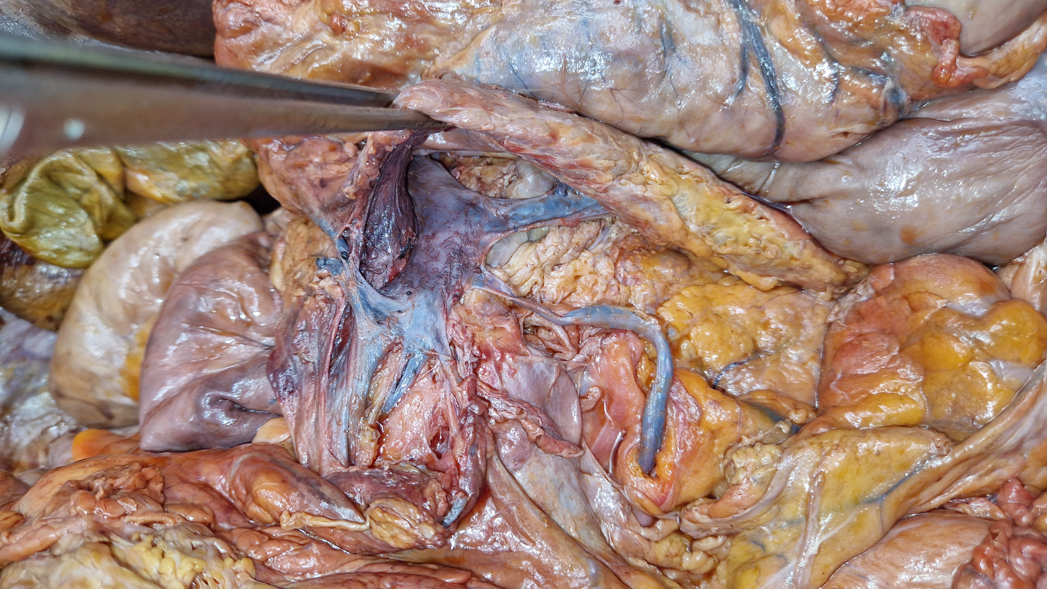



Pancreas
kop
Maag
Vena Portae Hepatis
Pancreas
Vena Splenica / Lienalis
Confluens
Duodenum
Vena Mesenterica
Inferior
(VMI)
Vena Mesenterica Superior (VMS)

Slide 3
Head of
Pancreas
Stomach
Portal Vein
Pancreas
Splenic Vein
Confluens
Duodenum
Inferior Mesenteric Vein
Superior Mesenteric Vein

