Slide 1

Leiden - Photo internal view male inguinal region - English labels
By O. Paul Gobée, LUMC, license: CC BY-NC-SA

Slide 2
Note: this presentation contains some variations of labelling, crop and zoom level of photo's of the same specimen

Slide 3
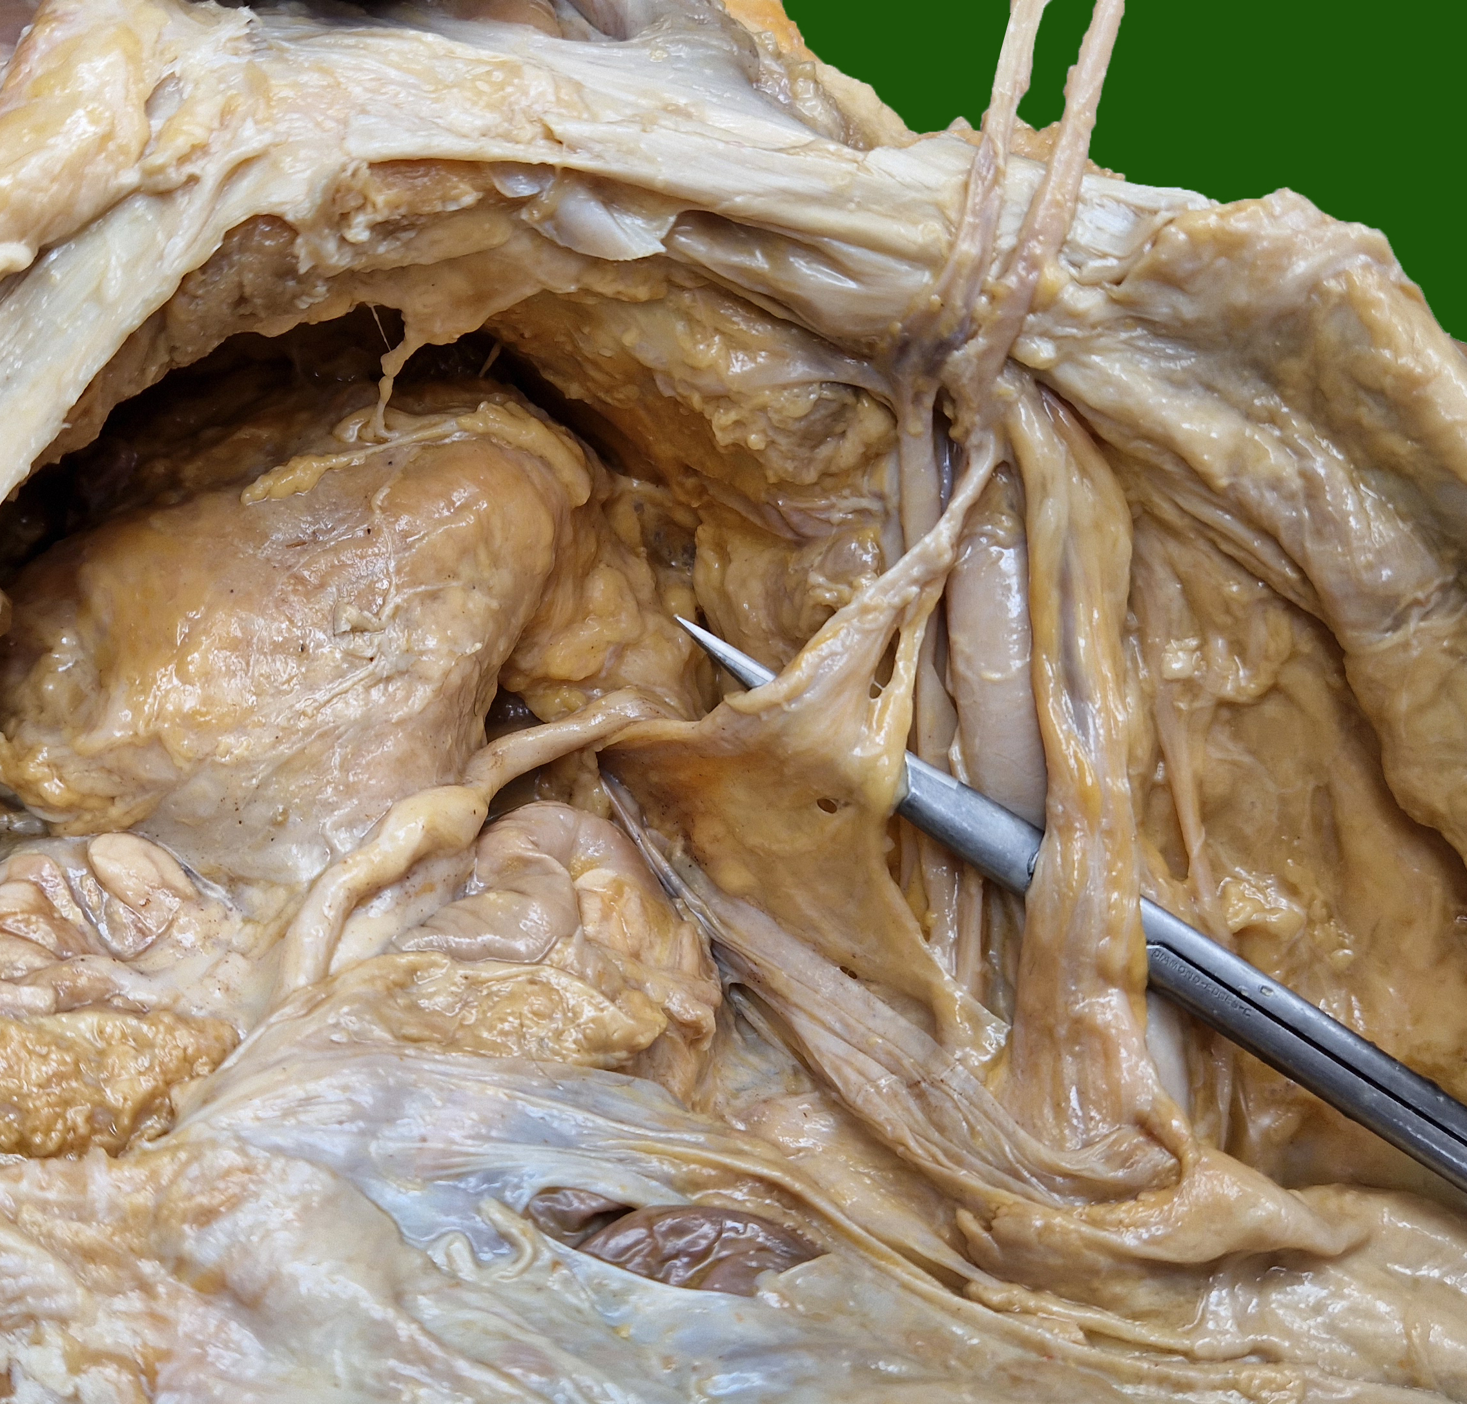



inferior epigastric vein and artery
pubic bone
pectineal ligament (Cooper’s)
retropubic space (Retzius)
deep inguinal ring
femoral ring,
entrance of
femoral canal
bladder
iliopubic tract
testicular artery and vein
deferent duct
peritoneum
external iliac vein
external iliac artery

Slide 4
a/v. epigastrica inferior
(os) pubis
lig. pectineum (Cooper’s)
spatium retropubicum (Retzius)
anulus inguinalis profundus / internus
anulus femoralis, ingang van canalis femoralis
blaas
lokatie lig. inguinale (bedekt door tractus iliopubicus)
ductus deferens
a/v. testicularis
peritoneum
v. iliaca externa
a. iliaca externa

Slide 5
inferior epigastric vein and artery
pubic bone
pectineal ligament (Cooper’s)
retropubic space (Retzius)
deep inguinal ring
femoral ring,
entrance of
femoral canal
iliopubic tract
bladder
deferent duct
testicular artery and vein
peritoneum
external iliac vein
external iliac artery

Slide 6
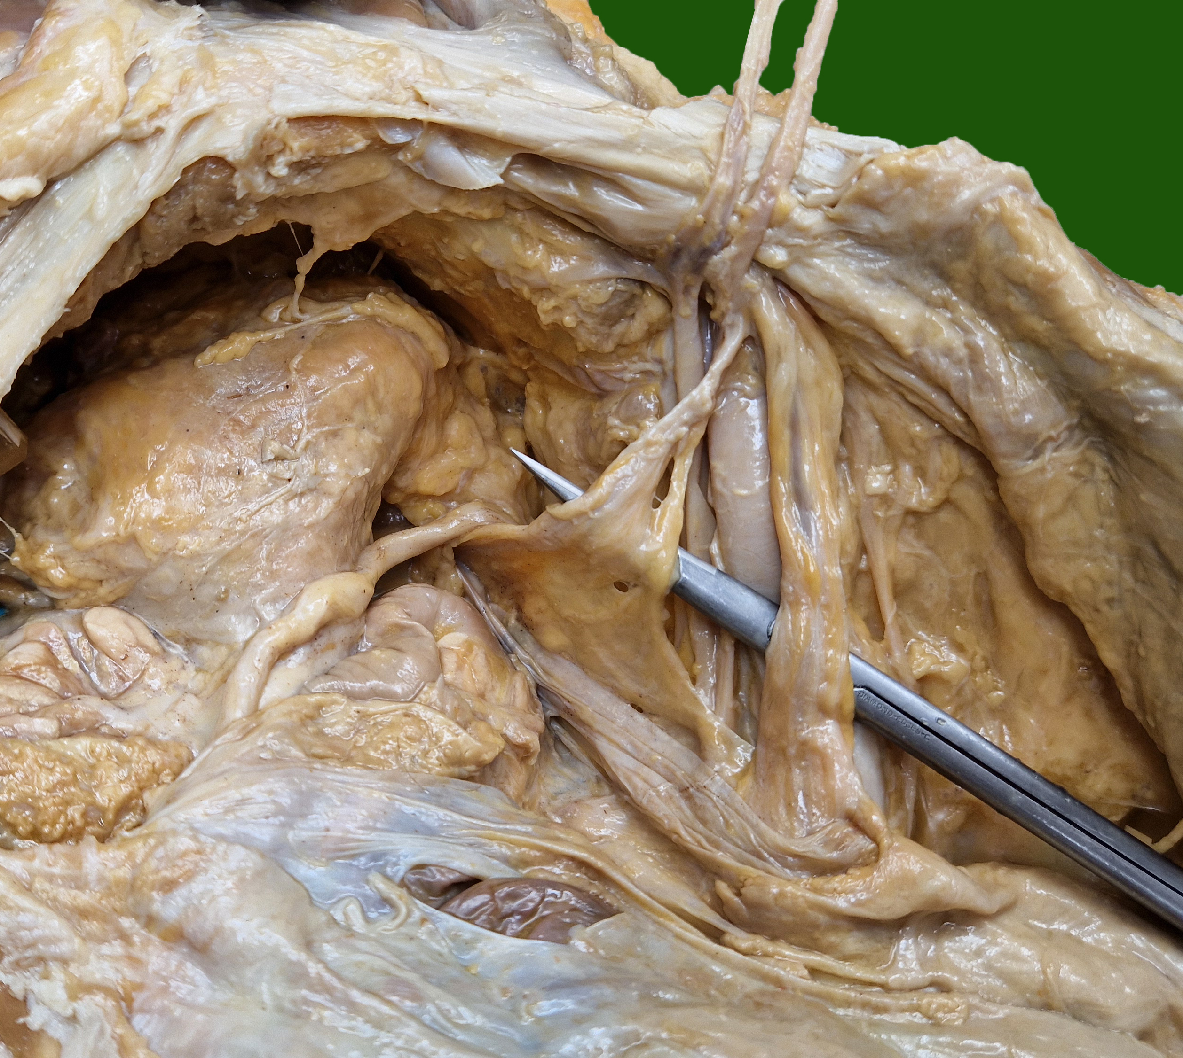
inferior epigastric vein and artery
pubic bone
pectineal ligament (Cooper’s)
retropubic space (Retzius)
deep inguinal ring
femoral ring,
entrance of femoral canal
iliopubic tract
bladder
deferent duct
testicular artery and vein
peritoneum
external iliac vein
external iliac artery

Slide 7
a/v. epigastrica inferior
(os) pubis
pectineal ligament (Cooper’s)
spatium retropubicum (Retzius)
anulus inguinalis profundus / internus
anulus femoralis, ingang van canalis femoralis
lokatie lig. inguinale (bedekt door tractus iliopubicus)
blaas
ductus deferens
a/v. testicularis
peritoneum
v. iliaca externa
a. iliaca externa

Slide 8
A more zoomed out photo of the same specimen

Slide 9
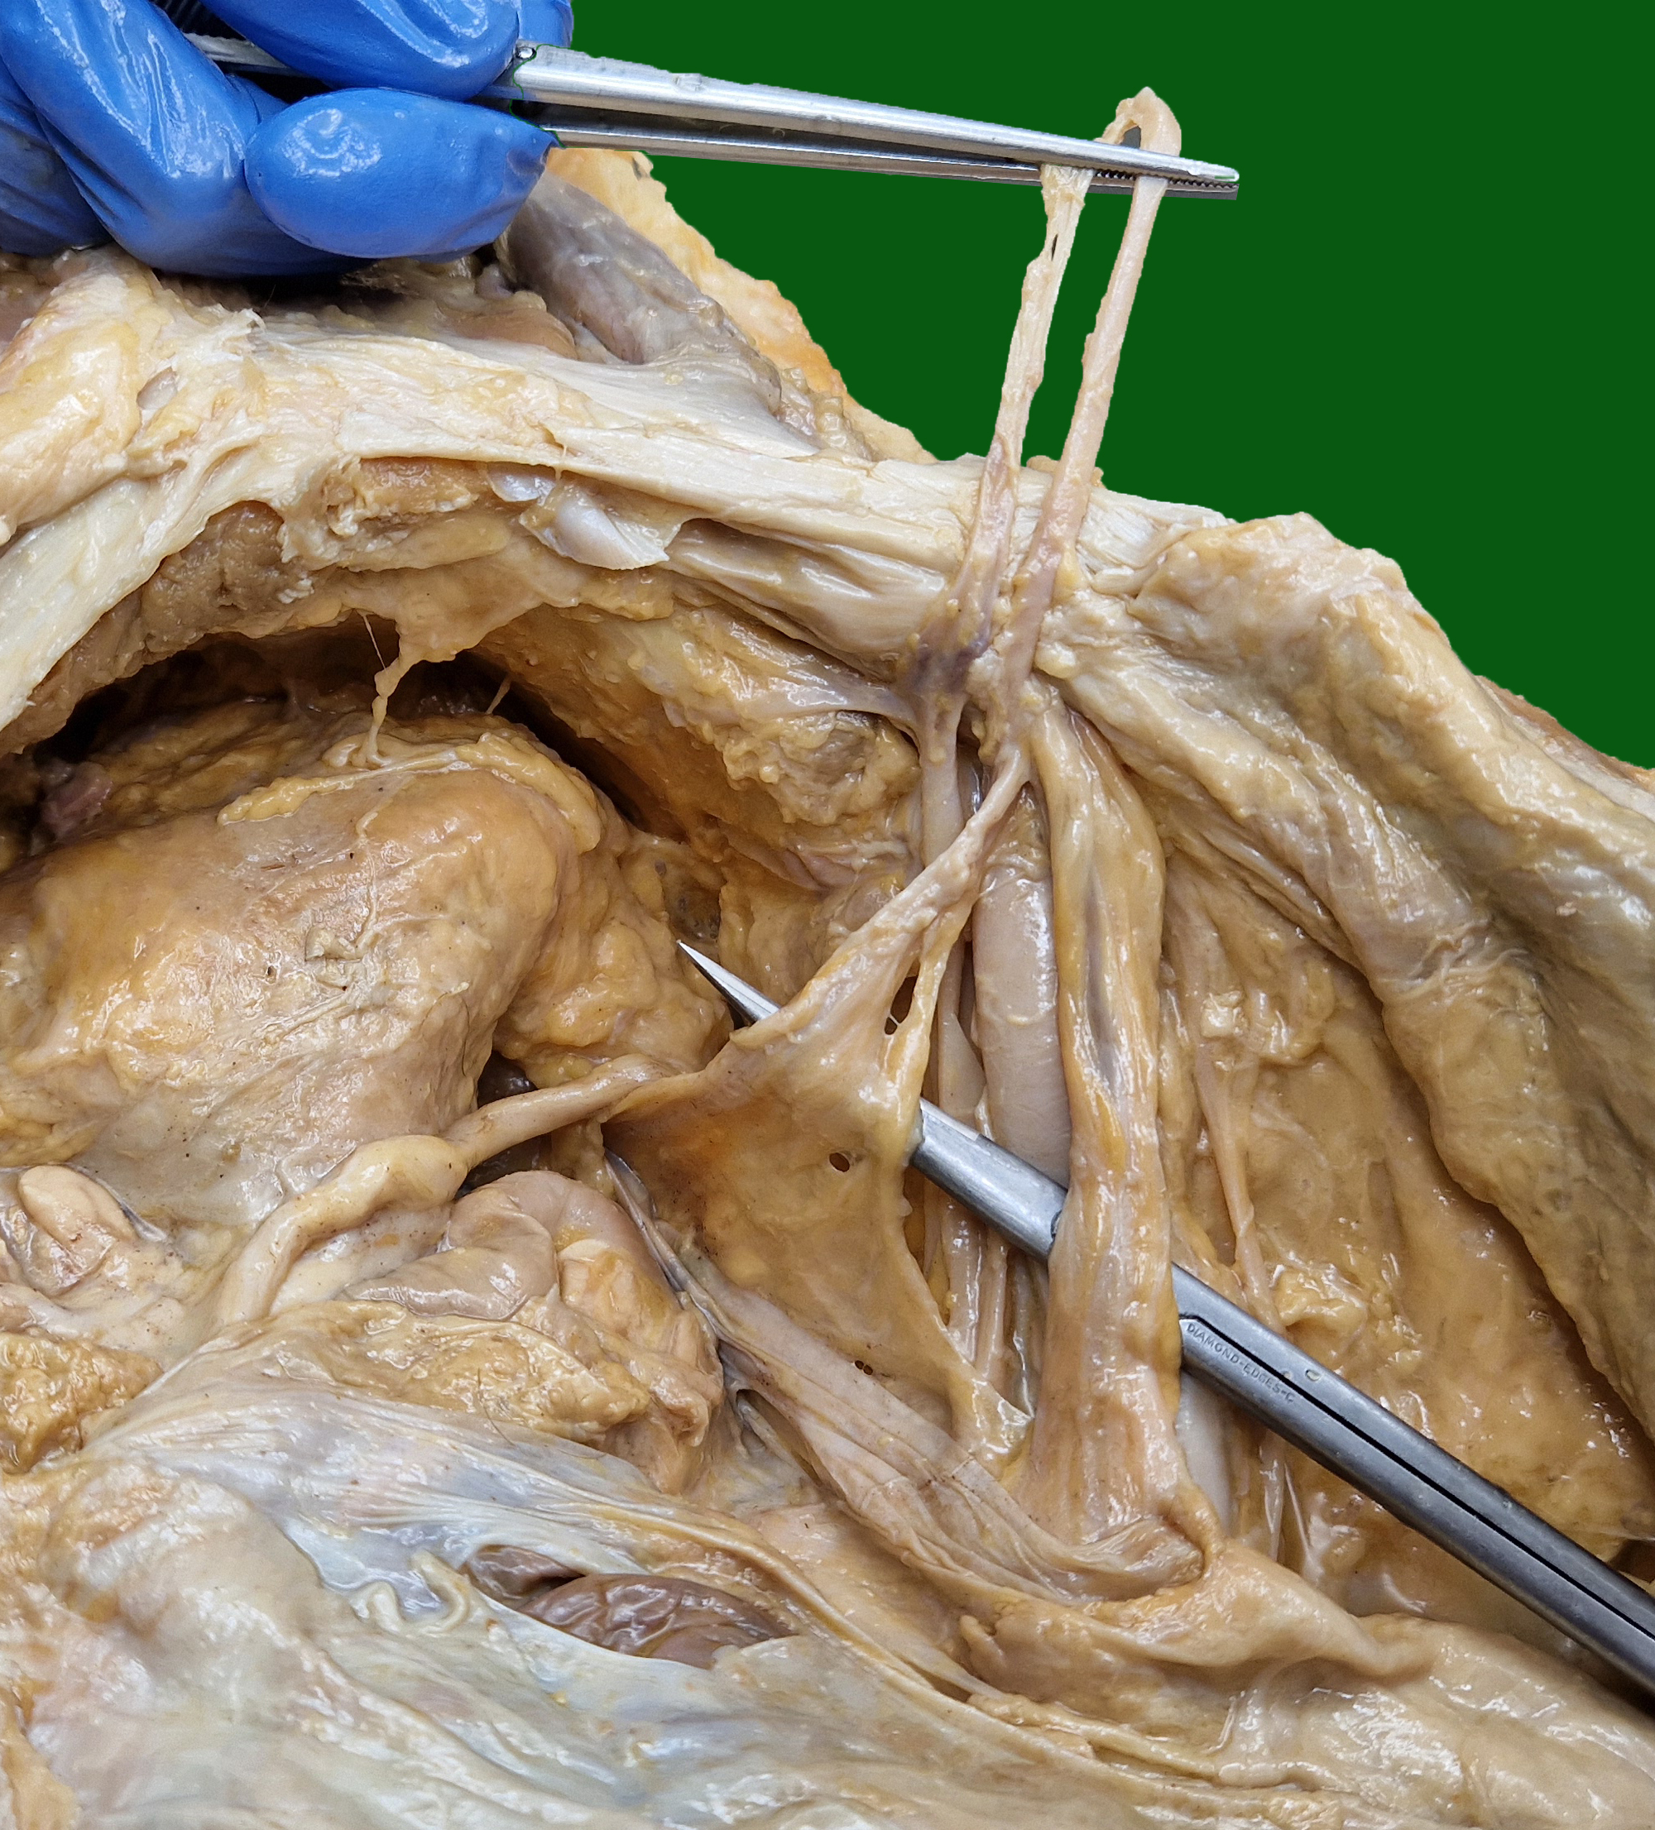
inferior epigastric vein and artery
pectineal ligament (Cooper’s)
pubic bone
retropubic space (Retzius)
deep inguinal ring
iliopubic tract
bladder
femoral ring,
entrance of femoral canal
testicular artery and vein
deferent duct
peritoneum
external iliac vein
external iliac artery

