Slide 1


Presentation slide
Subject
photo and labels: O. Paul Gobée, MD, dept. Anatomy& Embryology, LUMC
license: Creative Commons Attribution NonCommercial ShareAlike

Slide 2
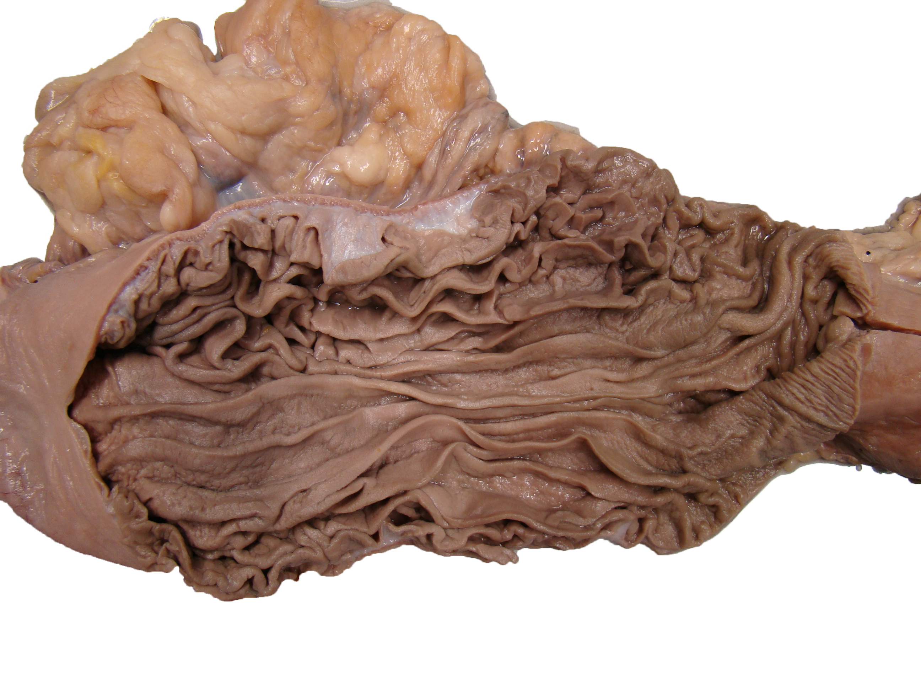
gastric canal

