Slide 1
Presentation slide Leiden - Photo Colon, mesocolon, marginal artery (dissection)
dissection: Myrthe van der Stappen, Caroline Wijers
photo, labels: O. Paul Gobée, MD, dept. Anatomy& Embryology, LUMC
license: Creative Commons Attribution NonCommercial ShareAlike

Slide 2
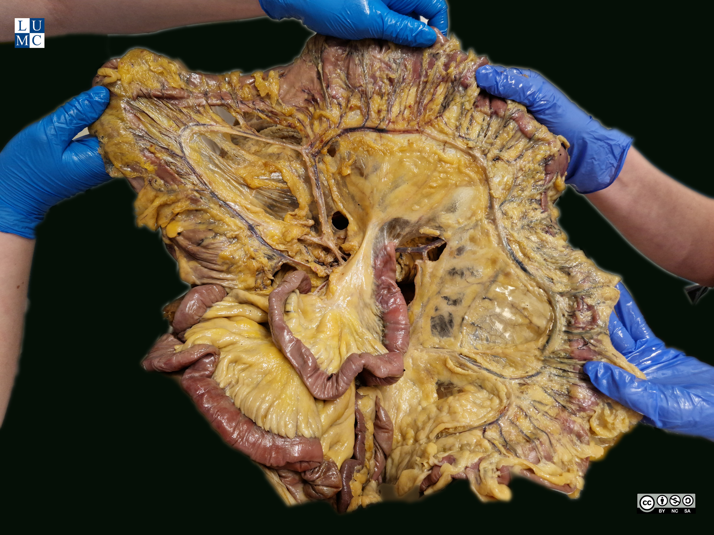
colon transversum
a. marginalis
a. marginalis
colon ascendens
a. marginalis
a. colica media
colon descendens
a. marginalis
a. colica dextra
a. colica sin.
a. marginalis
sigmoid

