Slide 1
Presentation slide Taenia libera and taenia omentalis
drawing: R. Slagter, NZIMBI, medical illustrator
labels: O. Paul Gobée, MD, dept. Anatomy& Embryology, LUMC
This image is based on Slagter - Drawing Large intestine with vascularisation and mesocolons - No labels
at https://anatomytool.org/content/slagter-drawing-large-intestine-vascularisation-and-mesocolons-no-labels
license: Creative Commons Attribution NonCommercial ShareAlike

Slide 2
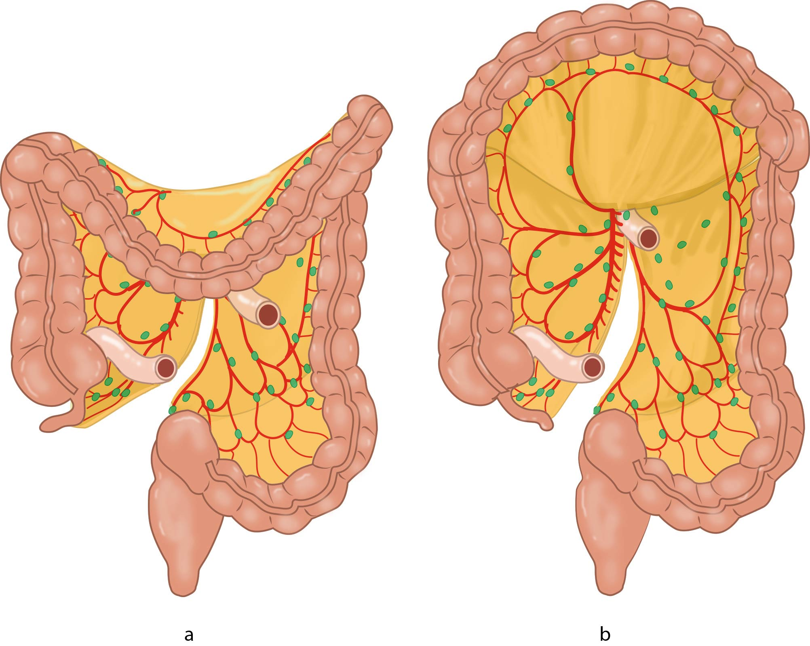
taenia omentalis
taenia libera

