Slide 1
Presentation slide Leiden - Drawing Nociceptive pathways in the pelvis
drawing: R. Slagter, NZIMBI, medical illustrator
labels: O. Paul Gobée, MD, dept. Anatomy& Embryology, LUMC
license: Creative Commons Attribution NonCommercial ShareAlike

Slide 2
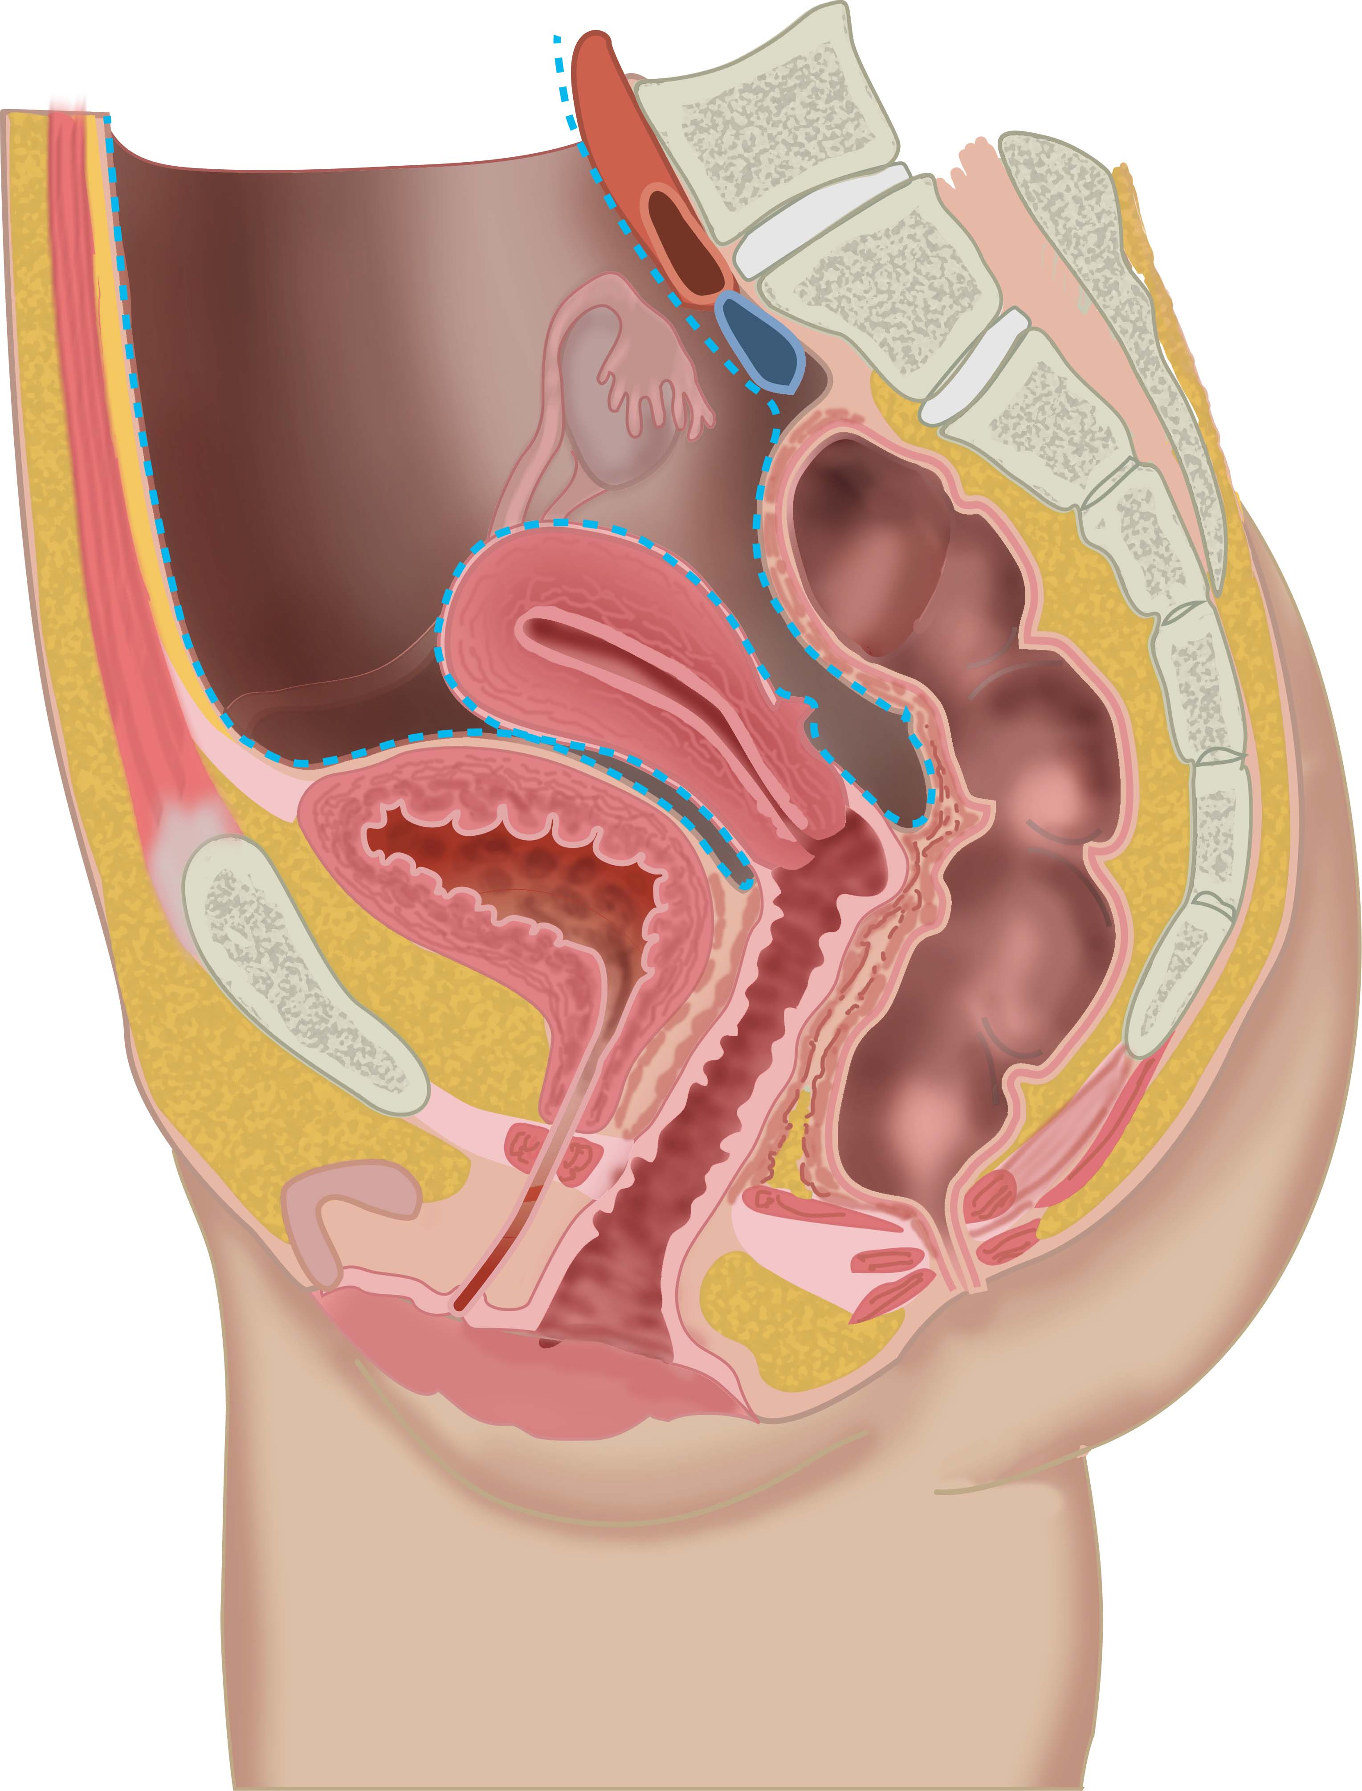
peritoneum
nociception via sympathetic thoracic and lumbar splanchnic nerves
pain line
nociception via parasympathetic pelvic splanchnic nerves to S2-S4
nociception via somatic nerves

