Slide 1
Presentation slide Leiden - Drawing Anteversion vs. Anteflexion of uterus - English labels
drawing: R. Slagter, NZIMBI, medical illustrator
labels: O. Paul Gobée, MD, dept. Anatomy& Embryology, LUMC
with consultation of dr. A.R.H. Twijnstra PhD, gynaecologist, LUMC
license: Creative Commons Attribution NonCommercial ShareAlike

Slide 2
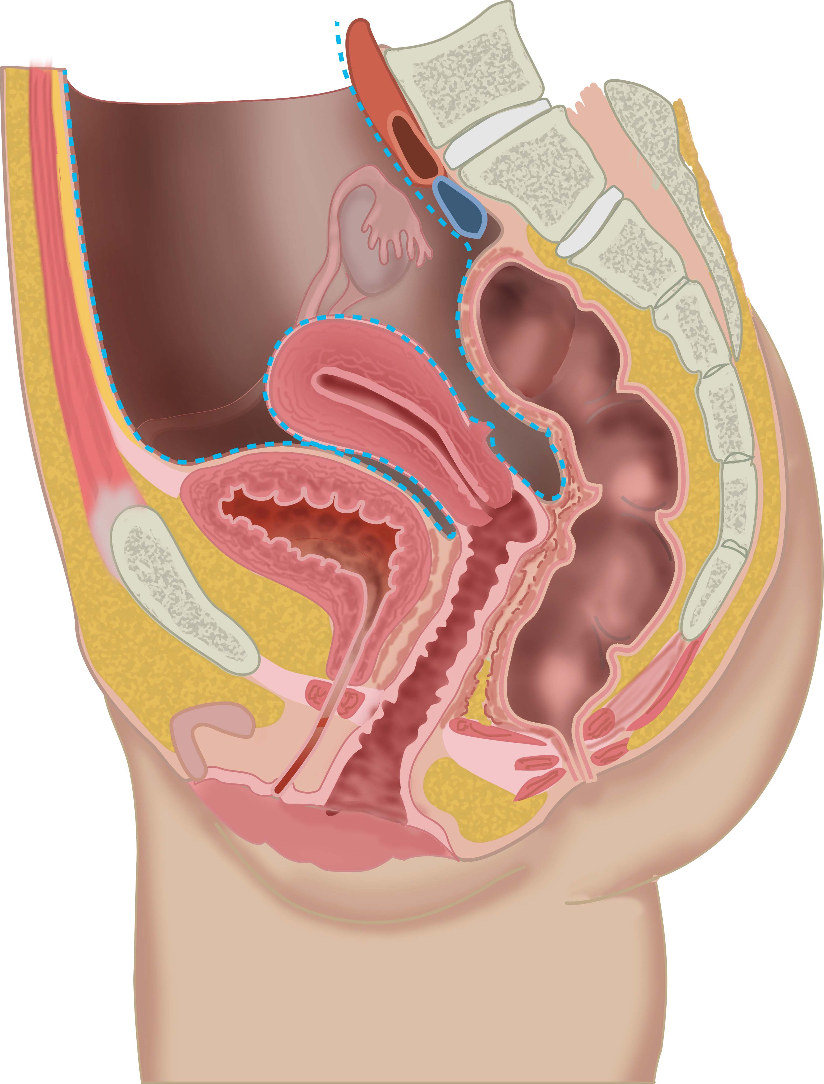
anteflexion
anteversion

