Slide 1
Presentation slide Biliary system
drawing: Jordi Marchn, MD, Wikimedia
labels: O. Paul Gobée, MD, dept. Anatomy& Embryology, LUMC
derived from: https://commons.wikimedia.org/wiki/File:Biliary_system_multilingual.svg
license: Creative Commons Attribution ShareAlike

Slide 2
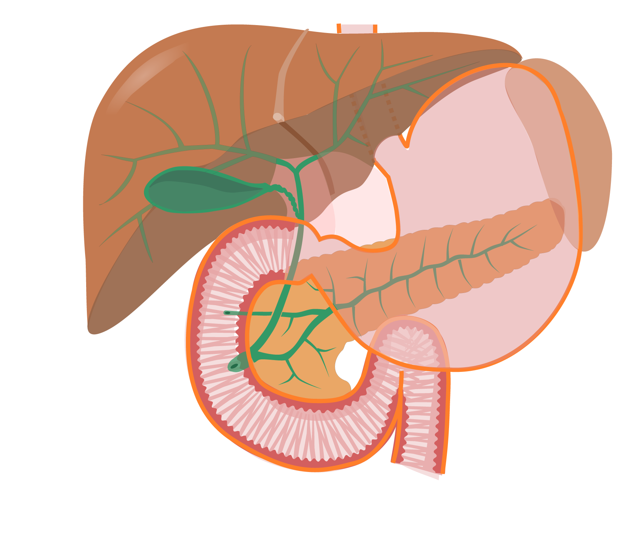
Ductus hepaticus dexter
Right hepatic duct
Ductus hepaticus sinister
Left hepatic duct
Vesica biliaris
Gallbladder
Ductus hepaticus communis
Common hepatic duct
Ductus cysticus
Cystic duct
Ductus choledochus
Bile duct
Papilla duodeni minor
Minor duodenal papilla
Ductus pancreaticus accessorius
Accessory pancreatic duct
(duct of Santorini)
Papilla duodeni major
Major duodenal papilla
(papilla of Vater)
Ductus pancreaticus
Pancreatic duct
(duct of Wirsung)

