Slide 1
Presentation slide Area of Ampulla hepatopancreatici (Vater)
drawing: Jordi Marchn, Wikimedia
labels: O. Paul Gobée, MD, dept. Anatomy& Embryology, LUMC
derived from: https://commons.wikimedia.org/wiki/File:Biliary_system_multilingual.svg
license: Creative Commons Attribution ShareAlike

Slide 2
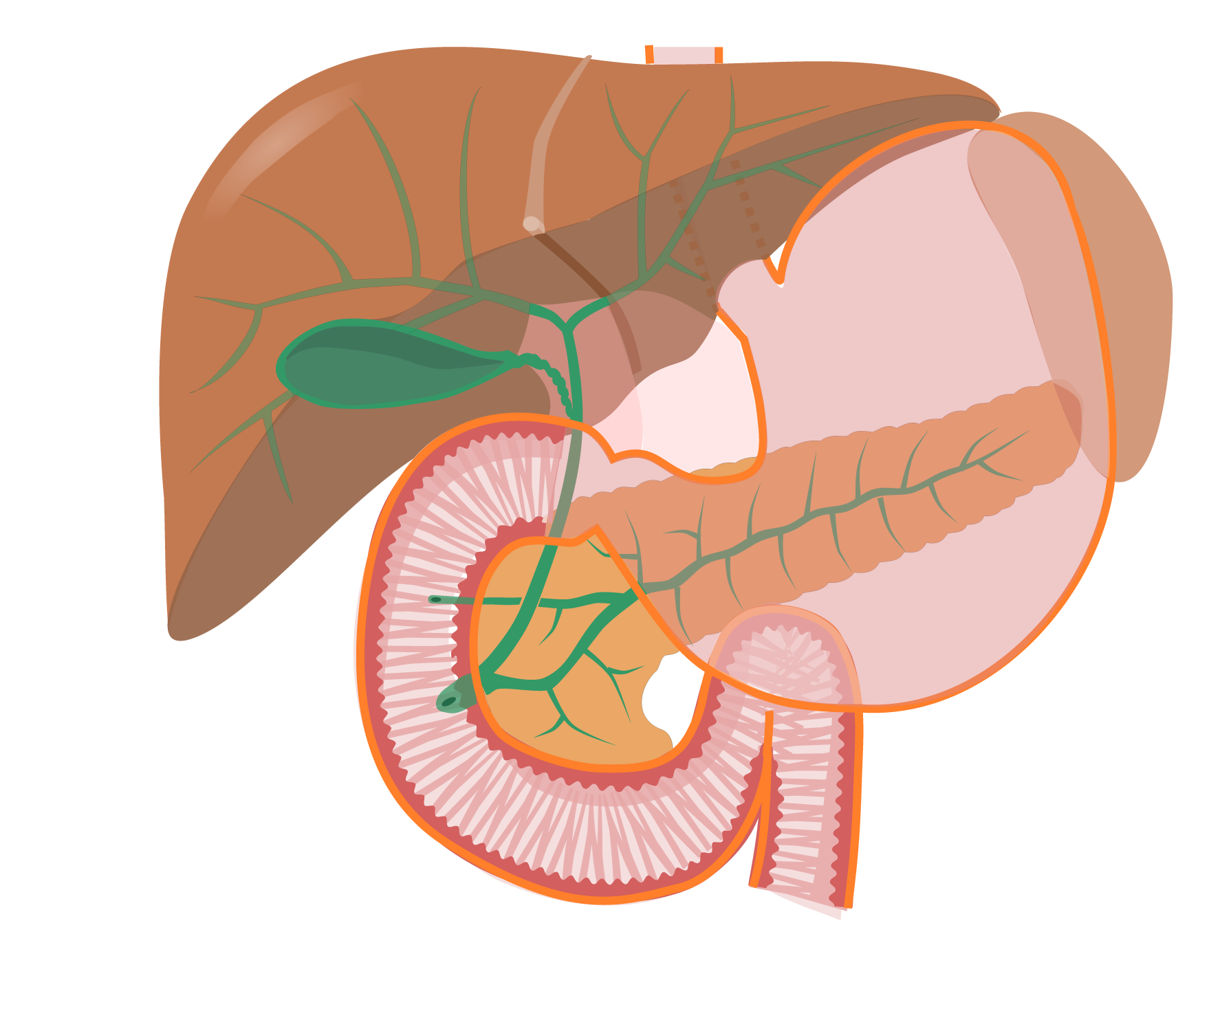
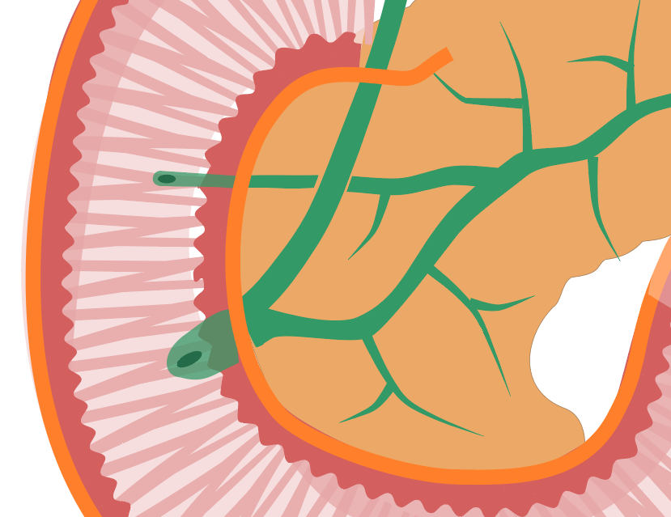
Ductus choledochus
Bile duct
Ductus pancreaticus accessorius
Accessory pancreatic duct
(duct of Santorini)
Ductus pancreaticus
Pancreatic duct
(duct of Wirsung)
DUODENUM
PANCREAS
Papilla duodeni minor
Minor duodenal papilla
M. sphincter ductus choledochi
Sphincter of bile duct
Papilla duodeni major
Major duodenal papilla
(papilla of Vater)
M. sphincter ductus pancreatici
Sphincter of pancreatic duct
M. sphincter ampullae
Sphincter of ampulla (sphincter of Oddi)
Ampulla hepatopancreatica
Hepatopancreatic ampulla
(ampulla of Vater)

