Slide 1
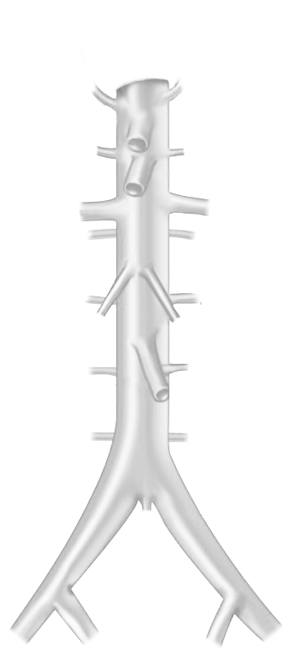
Schema Autonome zenuwstelsel
Truncus sympathicus (paravertebraal)
Nn. vagi, plexus oesophagealis, truncus vagalis ant. & post.
Cardiopulmonale splanchnische zenuwen
T1
T2
T3
Nn. intercostales (spinaal)
T4
Rami communicans
T5
T6
T7
T8
Thoracale splanchnische zenuwen:
N. splanchnicus major, minor, imus
T9
T10
T11
T12
Prevertebraal / preaortaal:
ganglion & plexus coeliacus, mesent. sup, aorticorenalis, intermesentericus, mesent. inf.
L1
L1
L2
L2
Plexus lumbalis, achterste buikwandzenuwen (spinaal)
L3
L3
Lumbale splanchnische zenuwen
L4
L4
Plexus hypogastricus superior
L5
L5
N. hypogastricus
S1
S1
Plexus sacralis, Nn. sacrales (spinaal)
S2
S2
Pelviene splanchnische zenuwen
S3
S3
Plexus hypogastricus inferior
S4
S4
Sacrale parasymp. outflow
S5
S5
SYMP
CZS
PARASYMP
Rami communicans
Spinale zenuwen
Pelviene splanchnische zenuwen
N. vagus
Splanchnische zenuwen
Paravertebraal (truncus sympathicus)
Prevertebraal / preaortaal
Download dit schema
ORGAAN
By Paul Gobée, dept. Anatomy & Embryology, LUMC license CC BY NC SA
Bronnen: Gray’s Anatomy 41st ed., Moore K et al, Clin. Oriented Anatoimy, 8th ed.
"Servier - Drawing Vertebral column anterior view - no labels" by Servier Medical Art, license: CC BY
"Branches of the abdominal aorta - English labels" by Open Learning Initiative, license: CC BY-NC-SA
v. 3, March 2024

