Slide 1
A starter on
Presentation by Paul Gobée, license: Creative Commons Attribution ShareAlike 4.0 Int.
Version 2, June 2024
Logo by the Noun Project. https://creativecommons.org/about/downloads. CC BY

Slide 2
What is Creative Commons?
Creative Commons is the international licensing system to share creative and academic works openly.
It facilitates reuse of creative and academic works, and building further on those works, by overcoming legal obstacles to do so.
The main way this is done, is by issuing a set of (Creative Commons) licenses that provide a simple, standardized way to give your permission to share and use your creative work— on conditions of your choice*.
They nevertheless have a solid legal underpinning.
*Partially copied from: https://creativecommons.org/share-your-work, licensed under a Creative Commons Attribution 4.0 International license

Slide 3
What do Creative Commons licenses offer?
Creative Commons licenses give everyone from individual creators to large institutions a standardized way to grant the public permission to use their creative work under copyright law.*
The licenses also contain a disclaimer of warranties and a limitation of liability.
From the reuser’s perspective, the presence of a Creative Commons license on a copyrighted work answers the question, “What can I do with this work?” *
*Copied from: https://creativecommons.org/about/cclicenses/
This text is licensed under a Creative Commons Attribution 4.0 International license

Slide 4
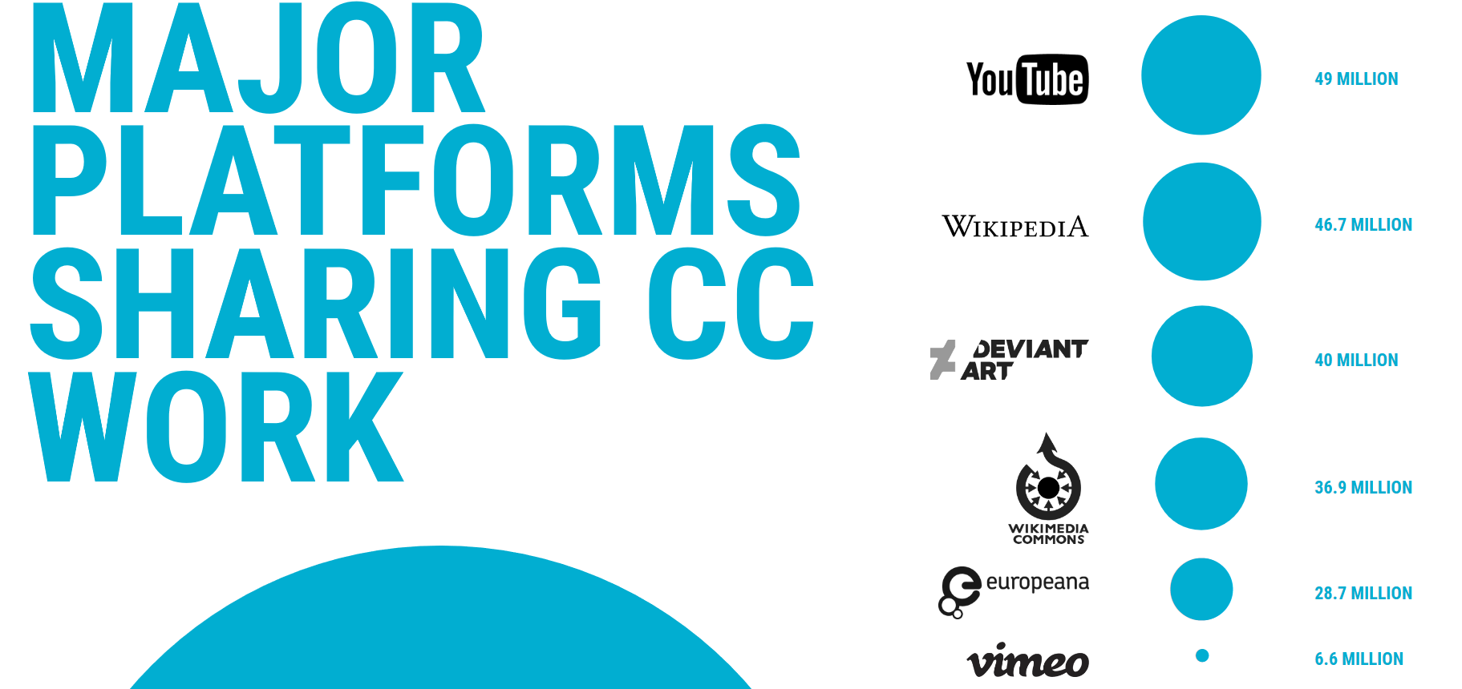
2024: 2.5 billion works under Creative Commons license https://creativecommons.org/share-your-work/platform/
https://stateof.creativecommons.org/#data

Slide 5
The basic idea: Creative Commons licenses form a mid way between Copyright and Public Domain.
It’s mine, but it’s okay if you do a,b,c as long as...
It’s mine!!!
You’re not allowed to copy it!!
I don’t care.
Do with it what you like.
©
Creative Commons
Public Domain
Copyright
Figure By Paul Gobée CC BY, Logo’s by the Noun Project. https://creativecommons.org/about/downloads. CC BY

Slide 6
You can ‘tag’ your work with (combinations of) 4 elements that denote specific restrictions.
Attribute (BY)
ShareAlike (SA)
NonCommercial (NC)
NoDerivatives (ND)

Slide 7
Explanation of the CC elements
ND
SA
BY
https://researchguides.library.wisc.edu/ld.php?content_id=27362686 CC BY
NC

Slide 8
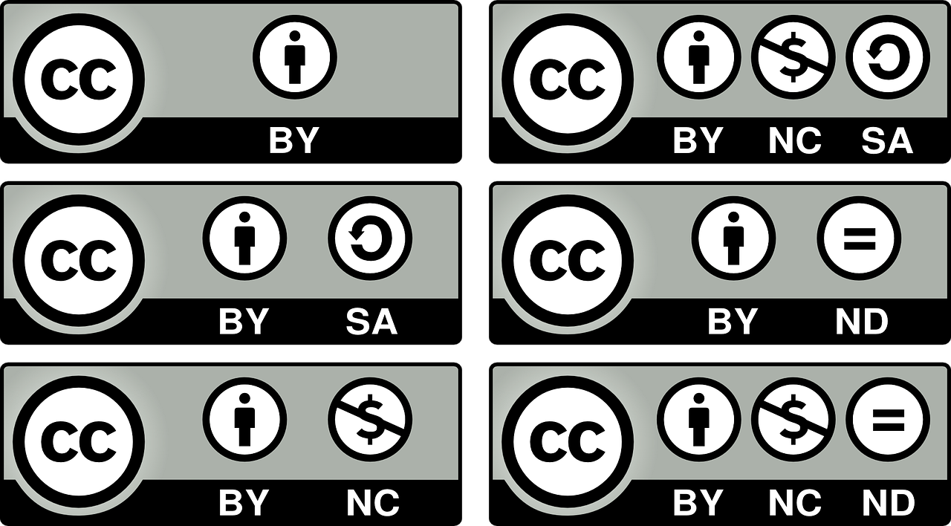
The elements are combined to 6 licenses.
Attribution
Attribution ShareAlike
Attribution NonCommercial
Attribution NonCommercial ShareAlike
Attribution NoDerivatives
Attribution NonCommercial NoDerivatives

Slide 9
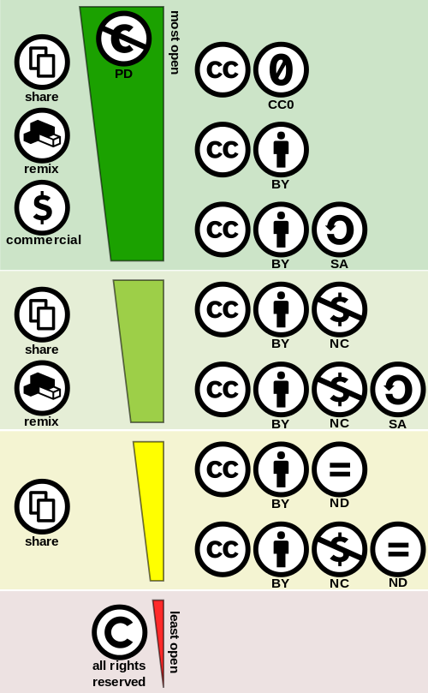
These 6 licenses form a spectrum from most open to least open
https://commons.wikimedia.org/wiki/File:Creative_commons_license_spectrum.svg By Shaddim; original CC license symbols by Creative Commons. License: CC BY

Slide 10
Let’s have a look at this license (Attribution ShareAlike – CC BY SA) as example
https://commons.wikimedia.org/wiki/File:Creative_commons_license_spectrum.svg By Shaddim; original CC license symbols by Creative Commons. License: CC BY

Slide 11
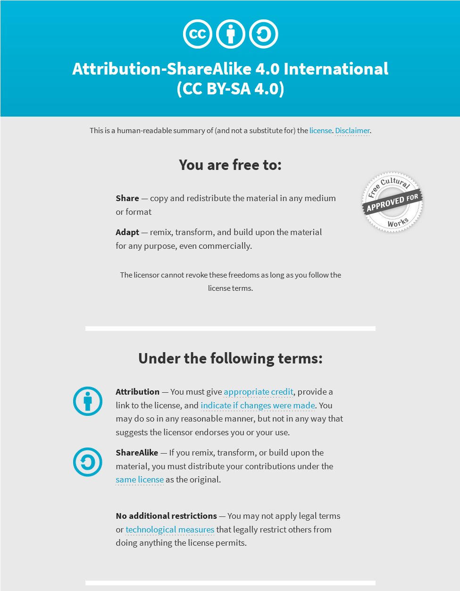
Example
the Attribution ShareAlike (CC BY SA) license
By the way, this is the license of all content on Wikipedia
What does the license allow and require?
There is an easy understandable summary

Slide 12
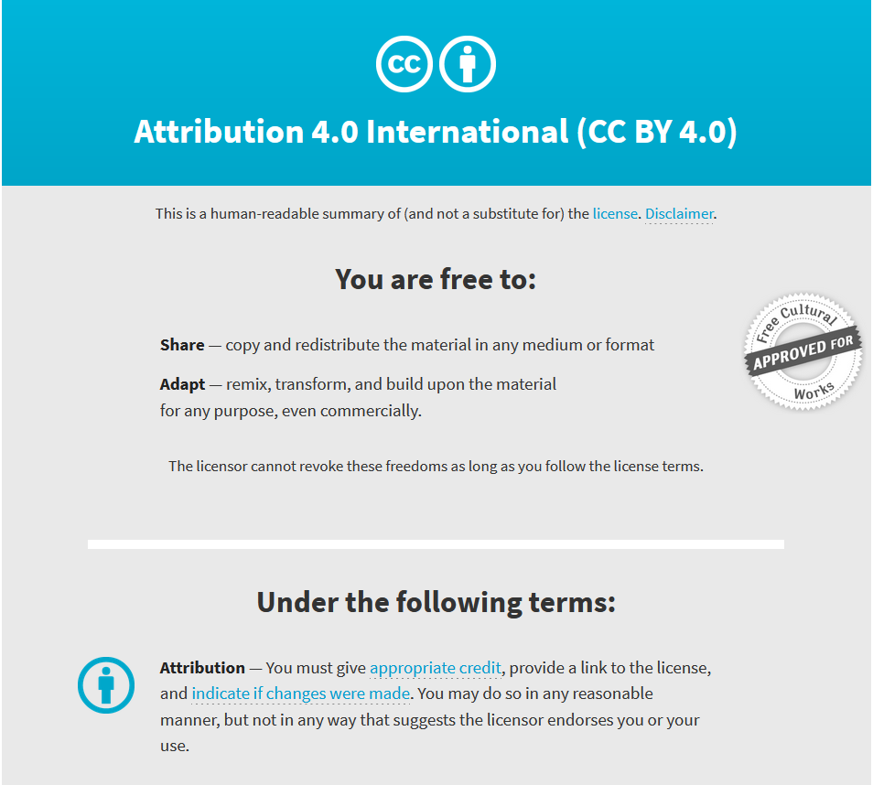
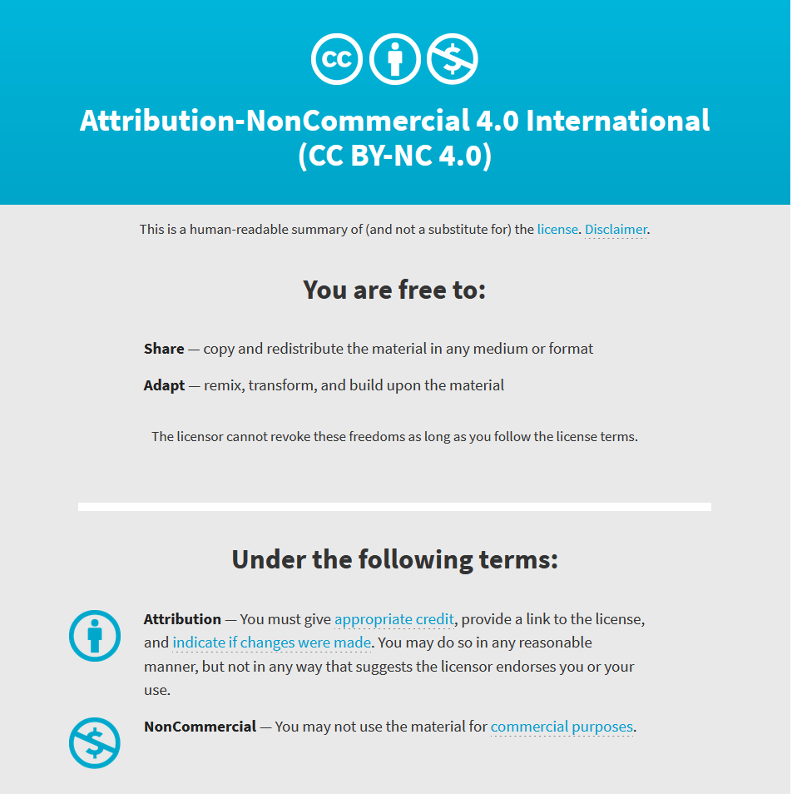
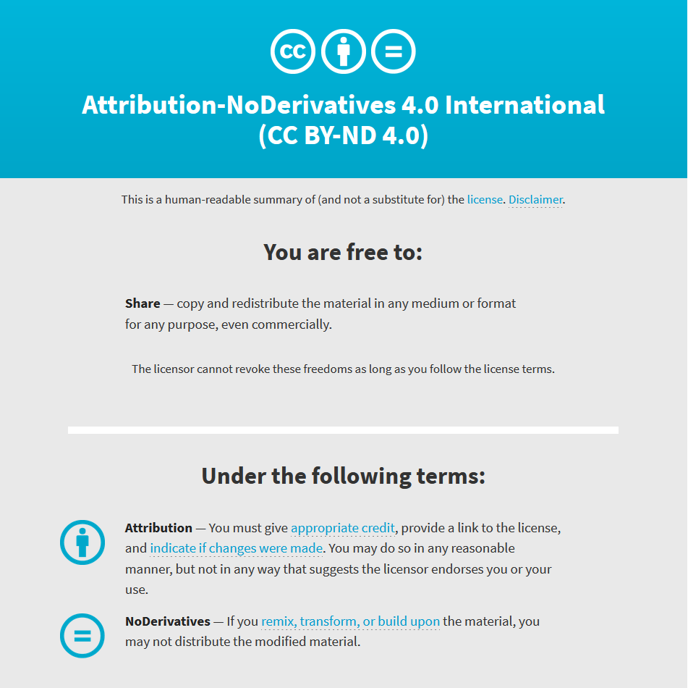
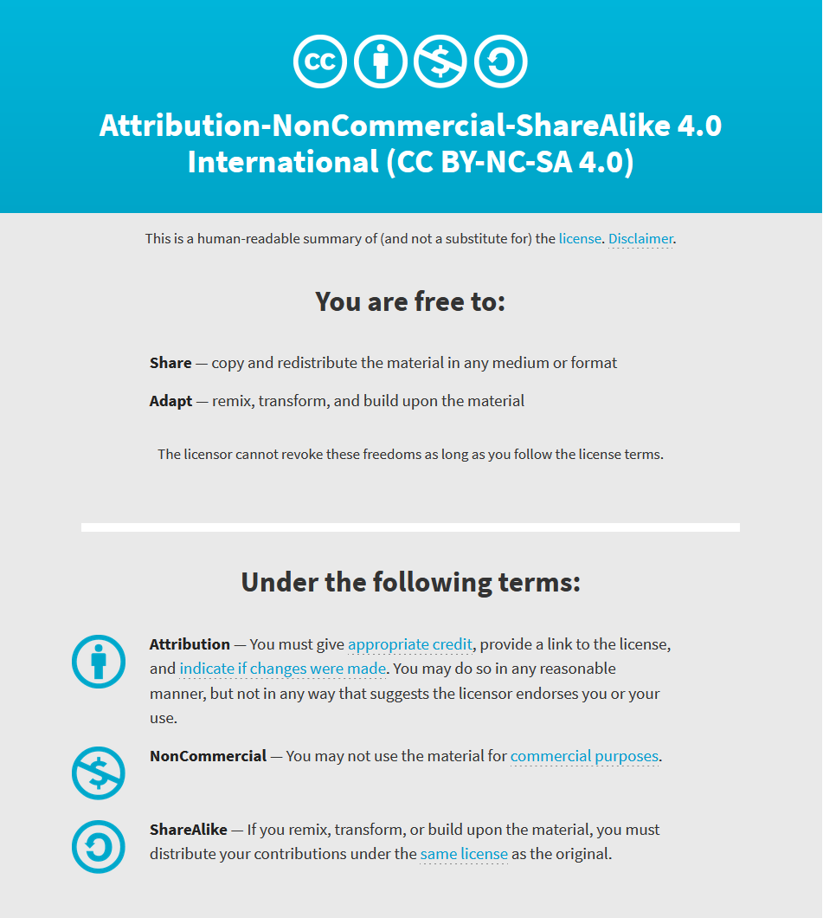
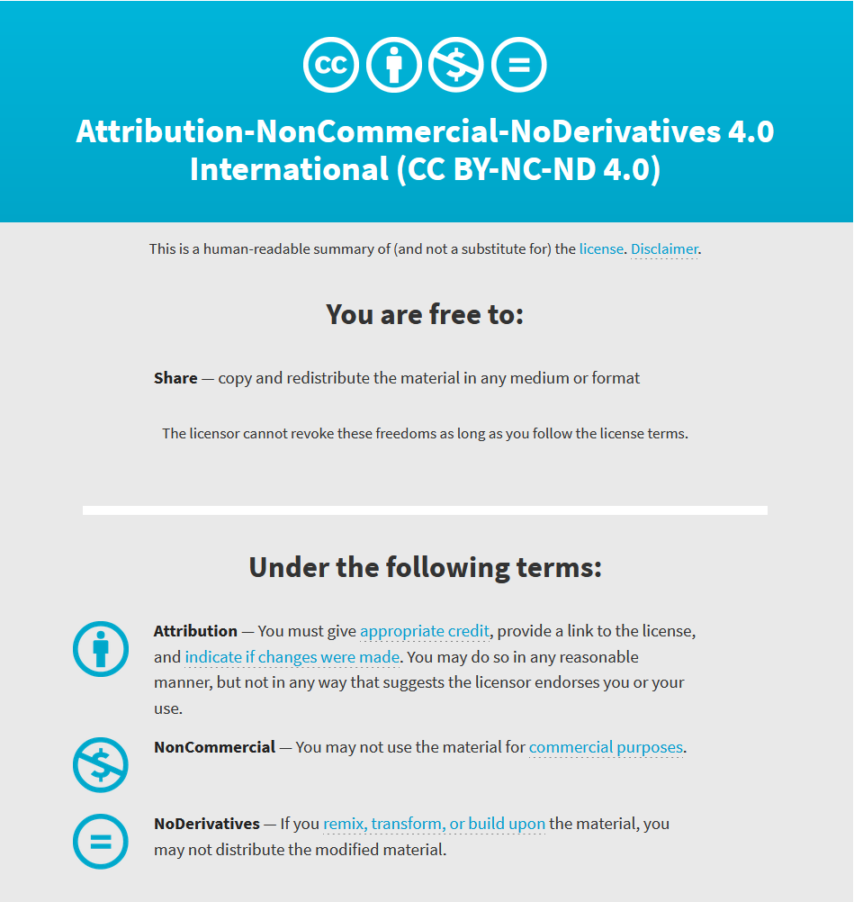
There is an easy understandable summary of each license on
https://creativecommons.org/about/cclicenses/

Slide 13
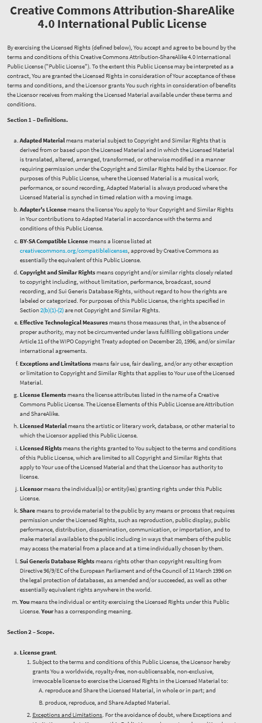
Behind the user friendly summary is an official legal text.
CC licenses have already stood the test by being honoured in real court cases.

Slide 14
Getting practical
How to license your work?
How to find existing CC licensed material?
How to use CC licensed material?

Slide 15
How to license your work?
How to find existing CC licensed material?
How to use CC licensed material?

Slide 16
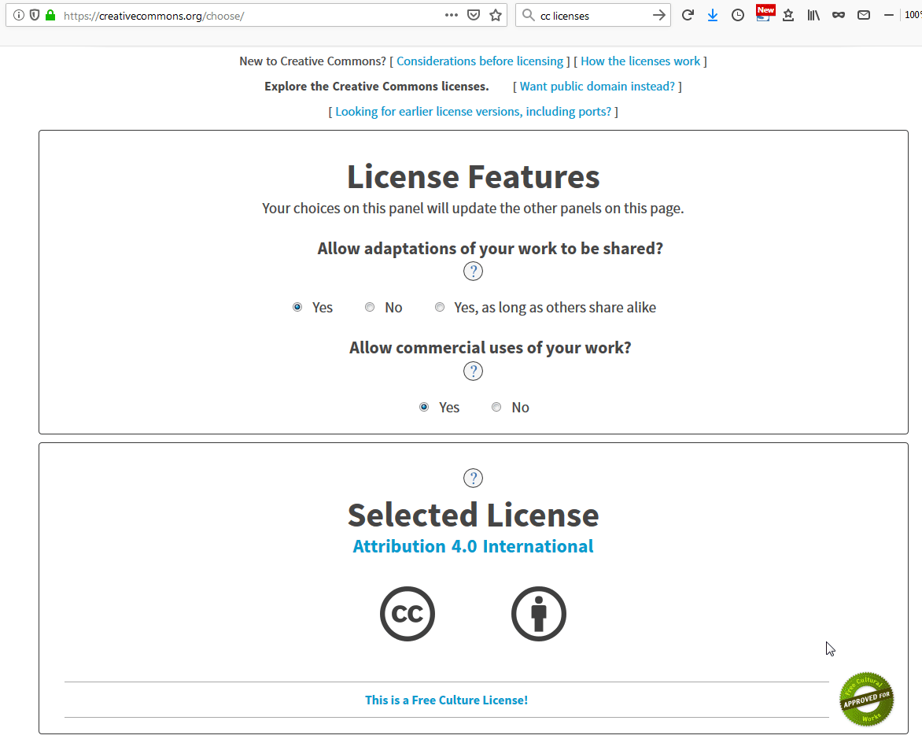
How to license your work?
https://creativecommons.org/choose/
Choose a license
Publish your material, marking it with the license
It’s not rocket science!
For instance, place the license below your image, or show it on the title page of your video

Slide 17
Example: on the title page of this presentation

Slide 18
Be aware!
The licenses and CC0 cannot be revoked. This means once you apply a CC license to your material, anyone who receives it may rely on that license for as long as the material is protected by copyright, even if you later stop distributing it.
You must own or control copyright in the work. Only the copyright holder or someone with express permission from the copyright holder can apply a CC license or CC0 to a copyrighted work. If you created a work in the scope of your job, you may not be the holder of the copyright.
Copied from: https://creativecommons.org/about/cclicenses/
This text is licensed under a Creative Commons Attribution 4.0 International license

Slide 19
How to license your work?
How to find existing CC licensed material?
How to use CC licensed material?

Slide 20
How to find existing CC licensed material?
Google

Slide 21
How to find existing CC licensed material?
Video – view in presentation mode
Google

Slide 22
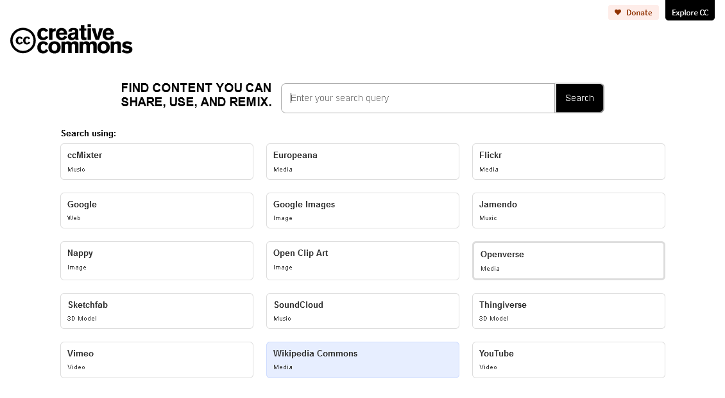
Search on the Creative Commons search site https://search.creativecommons.org/
How to find existing CC licensed material?
For instance to find CC licensed video’s on YouTube
Door O.P. Gobée

Slide 23
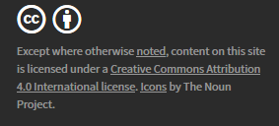
But do not completely rely on the search engine stating it is CC. Always check the license on the item itself. And remember anyone can (illegally) post someone’s else work online with a CC license - if it is too fabulous to be true, probably that’s what it is…

Slide 24
How to licenseyour work ?
How to find existing CC licensed material?
How to use CC licensed material?

Slide 25
How to use CC licensed material?
Only use the material in the way the license allows
Attribute the creator, stating the license
How to attribute?
State:
source
creator
license
https://creativecommons.org/use-remix/attribution/

Slide 26
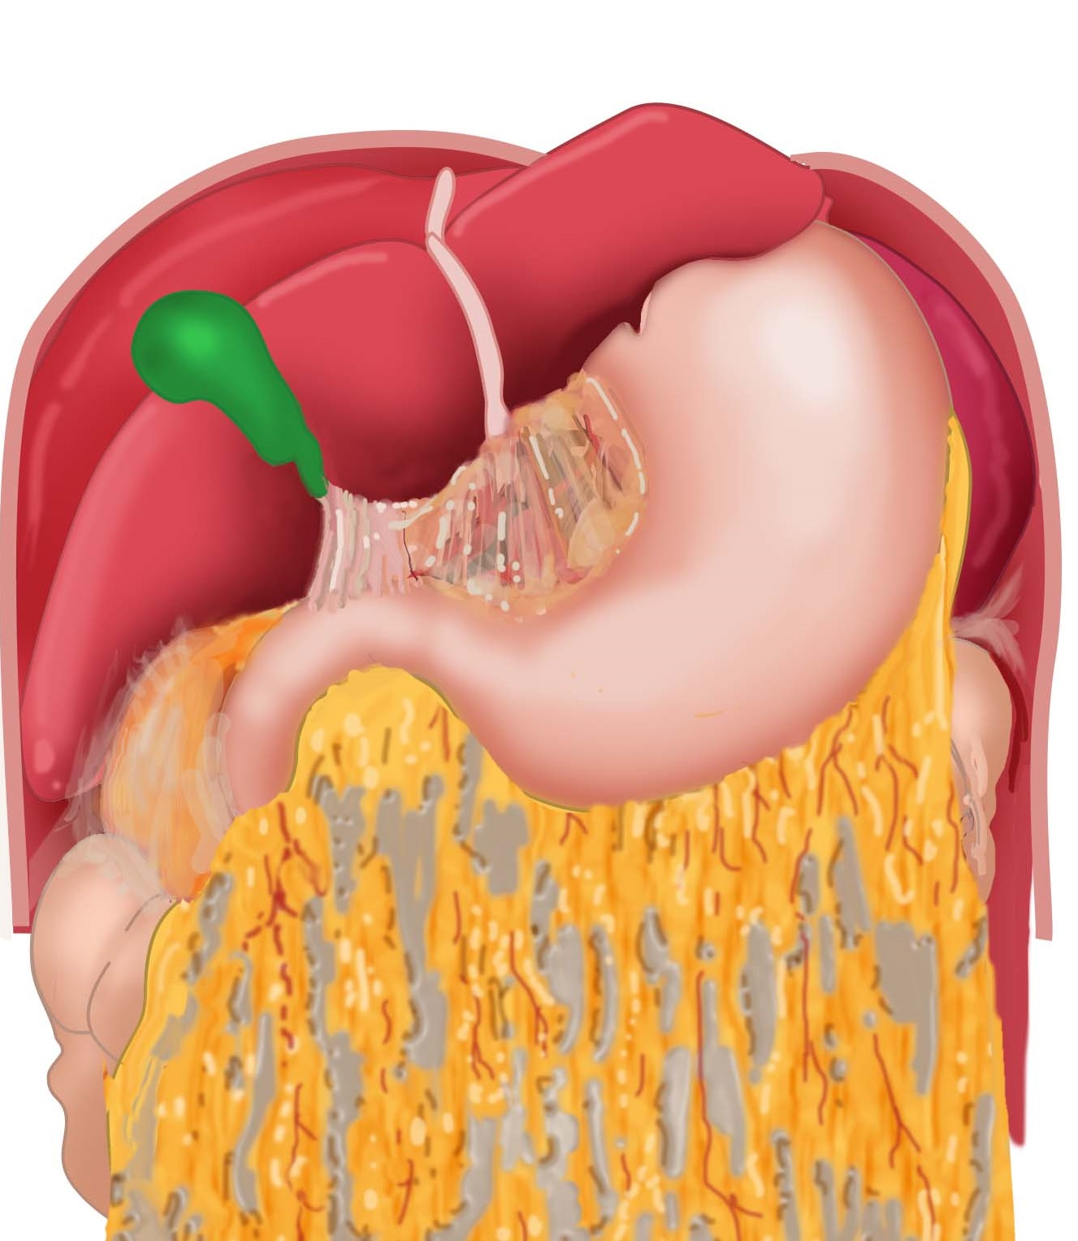
Example of attribution (on a lecture slide)
Omental bursa
https://anatomytool.org/content/slagter-drawing-upper-abdominal-organs-liver-reflected-superiorly-no-labels By Ron Slagter, LUMC Anatomy, License: CC BY NC SA
Slide from lecture O.P. Gobée, LUMC

Slide 27
Example of attribution
Omental bursa
Source
Creator
License
https://anatomytool.org/content/slagter-drawing-upper-abdominal-organs-liver-reflected-superiorly-no-labels By Ron Slagter, LUMC Anatomy, License: CC BY NC SA
https://anatomytool.org/content/slagter-drawing-upper-abdominal-organs-liver-reflected-superiorly-no-labels By Ron Slagter, LUMC Anatomy, License: CC BY NC SA
Slide from lecture O.P. Gobée, LUMC

Slide 28
Finally, a special one… CC0 - the “No Rights Reserved” tag
A tag to indicate that you expressly place your work in the Public Domain by waiving all your copyright and related rights in the tagged work.
Note: this means that a reuser does not need to attribute you, that your work could be scrambled, or exploited commercially or used in ways you may find distasteful or objectionable.
https://creativecommons.org/share-your-work/public-domain/cc0/

Slide 29
Read more
Quick reference
The 6 licenses https://creativecommons.org/about/cclicenses/
Using materials from others
How to attribute (best practices) https://wiki.creativecommons.org/wiki/Recommended_practices_for_attribution
Licensing your own material
Choose a license https://creativecommons.org/choose/
Considerations for licensing (detailed) https://wiki.creativecommons.org/wiki/Considerations_for_licensors_and_licensees
How to mark your work with the license (detailed) https://wiki.creativecommons.org/wiki/Marking_your_work_with_a_CC_license

Slide 30
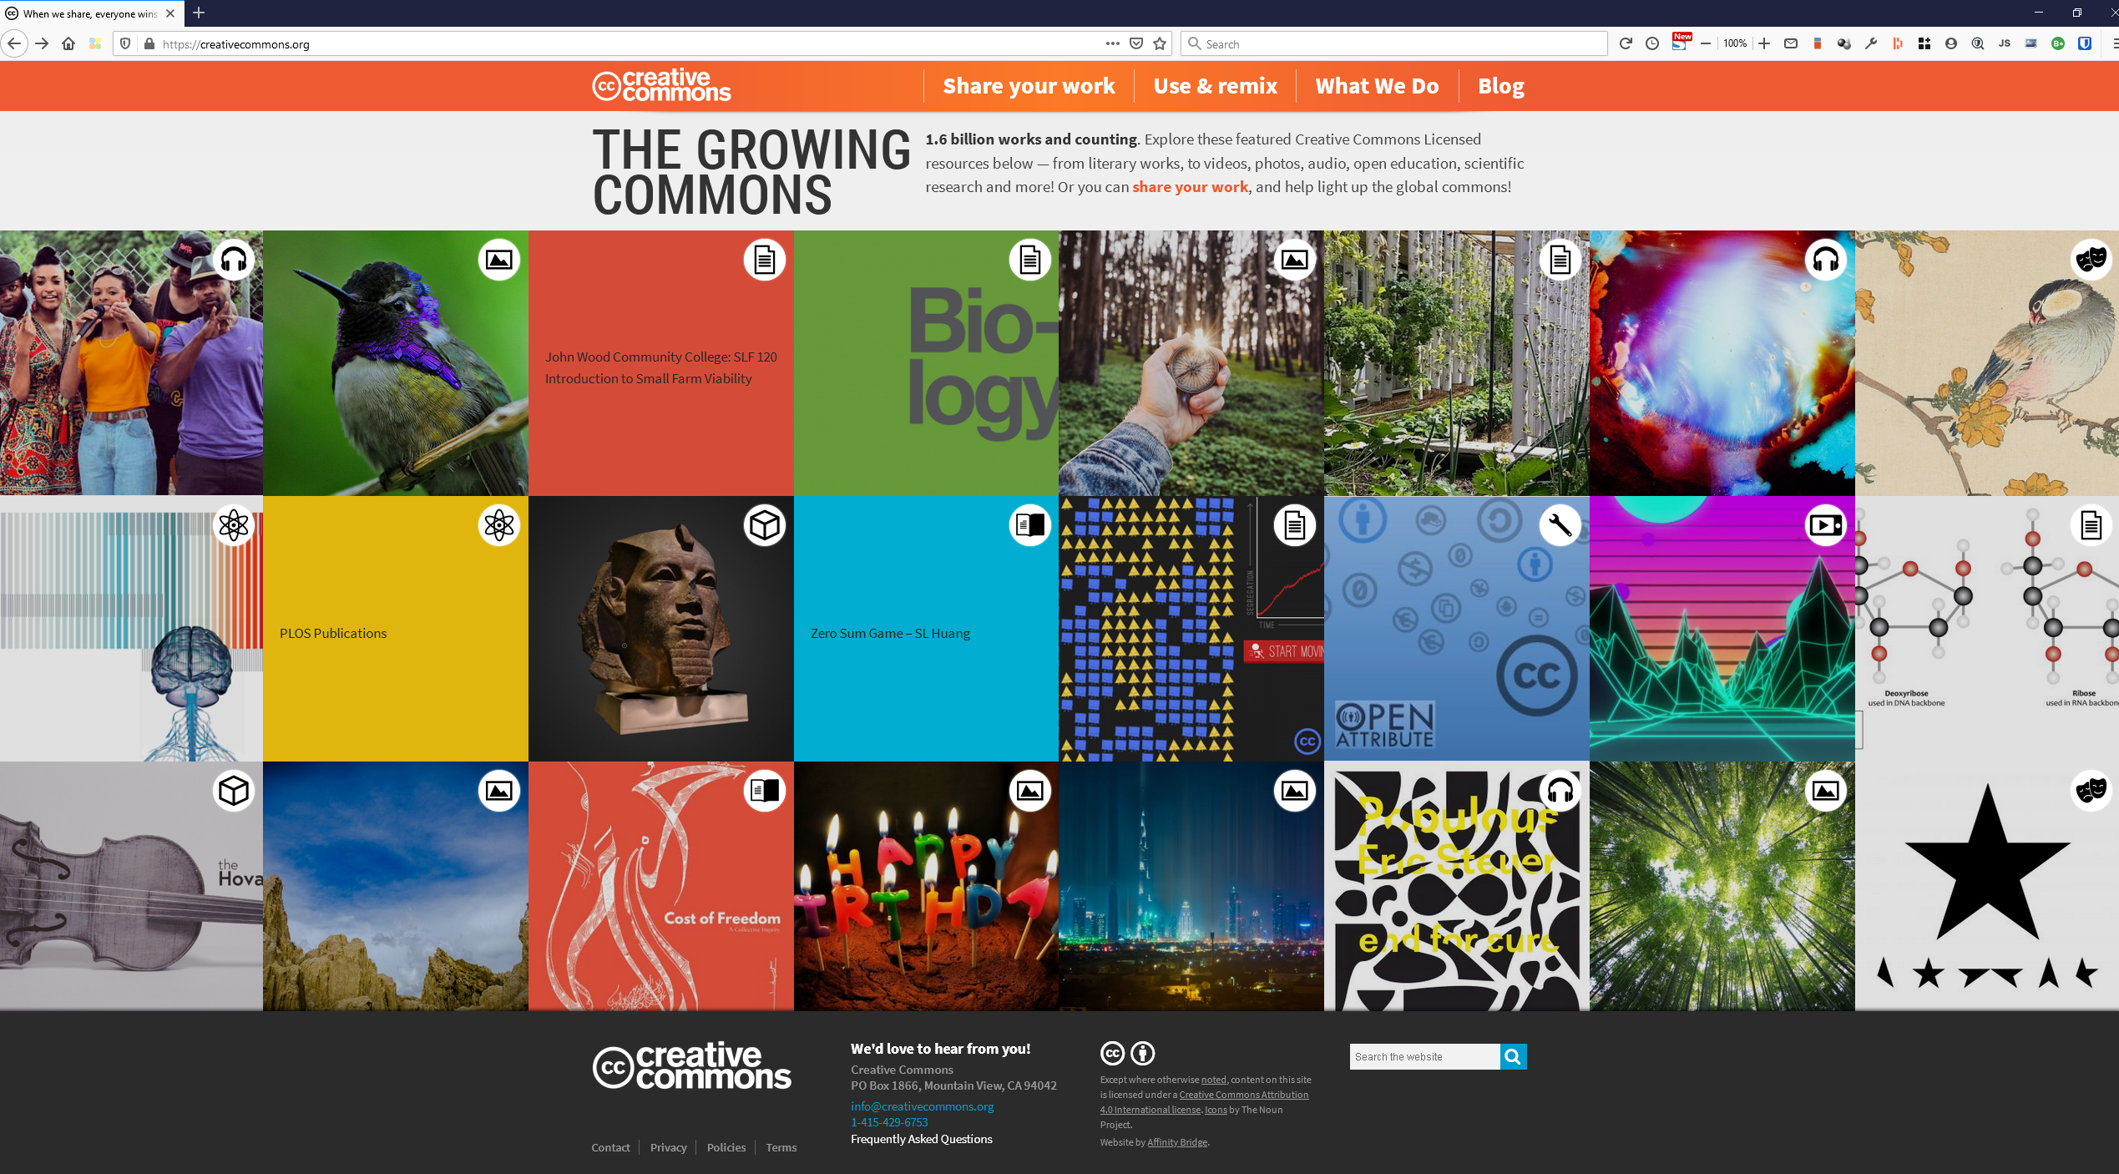
https://creativecommons.org

